Slide 1

UNITED STATES MILITARY
ENLISTED ACCESSIONS
NASHVILLE SOFTWARE SCHOOL CLASS DDA-14

Slide 2
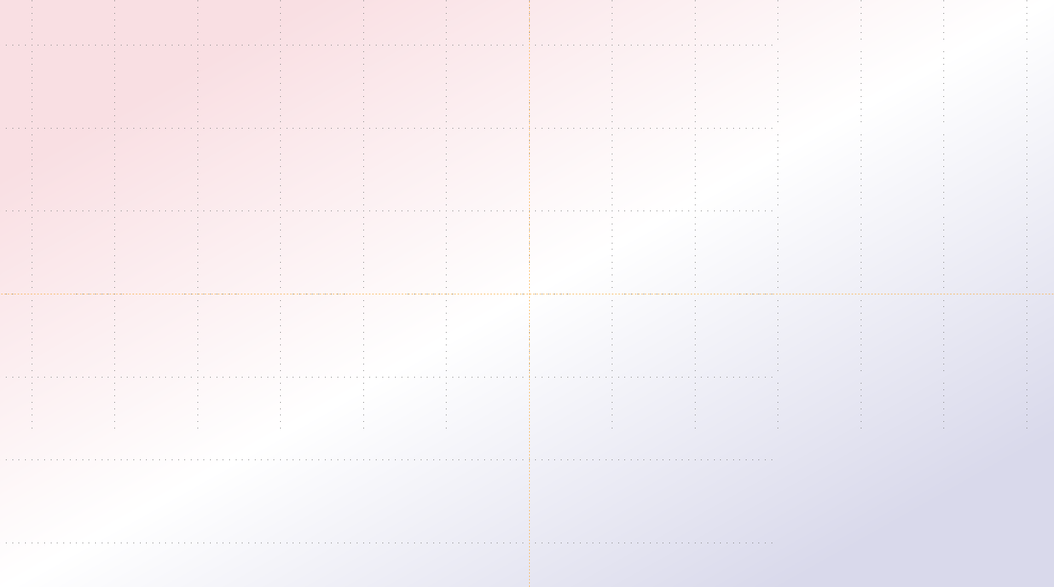


AGENDA
01
Introduction/Context
02
Overview
03
Project Questions and Findings
04
Limitations
05
Summary/Proposed Next Steps
06
Conclusion/Questions

Slide 3
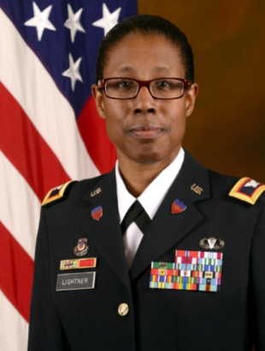
INTRODUCTION/CONTEXT
“Only 1 percent of our population today will ever wear the uniform of this nation in any of its incarnations -- soldier, sailor, airman, Marine, active, Guard or Reserve,” Air Force Gen. Paul J. Selva, Vice Chairman of the Joint Chiefs of Staff
Vice Chairman Salutes The 1 Percent of Population That Serves > U.S. Department of Defense > Defense Department News

Slide 4
BRIEFING NOTES
Department of Defense is DoD
I may use accession, enlistment, and recruiting interchangeably
I may refer to the period 2010 -2020 as decade
All years are fiscal years, except as noted below, annotated as FY on slides and a DoD fiscal year is from October 1st through September 30th
Gross Domestic Product (GDP) is measured in calendar years; therefore, I used the regular year for any graph using GDP

Slide 5
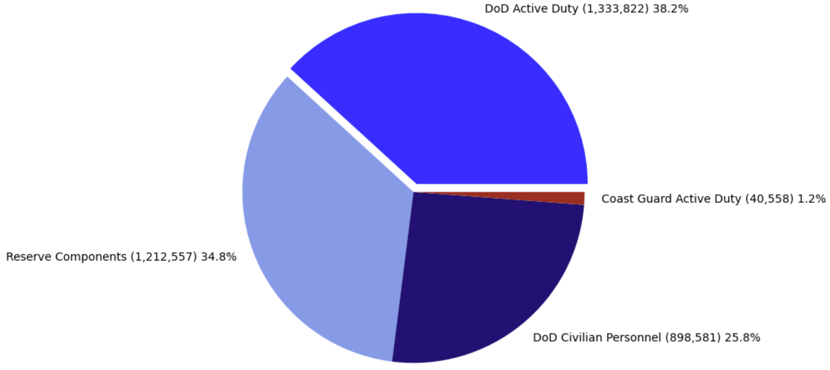
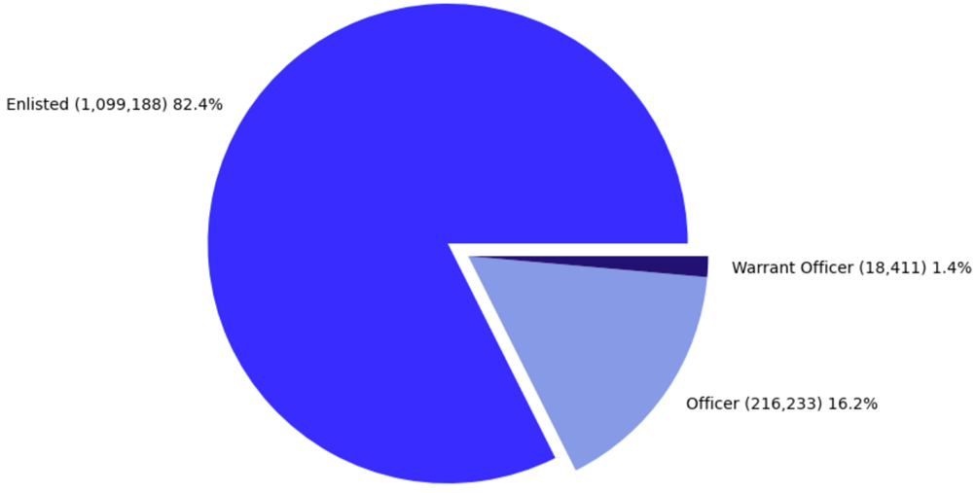
OVERVIEW
TOTAL FORCE BY COMPONENT FY2020

Slide 6
PROJECT QUESTIONS AND FINDINGS
PQ3: Is
there a relationship between GDP Per Capita and Enlisted Accessions?
PF3: No. The correlation between GDP Per Capita and Enlistment is very weak
PQ1: What are the Enlisted Accession trends over time?
PF1: Enlisted Accession have been decreasing over time
PQ2: Are there areas
where Enlisted Accessions differs from the population?
PF2:
*NORTHEAST< *MIDWEST< *SOUTH> *WEST =

Slide 7


PROJECT QUESTION 1
What are the Enlisted Accession trends over time?

Slide 8
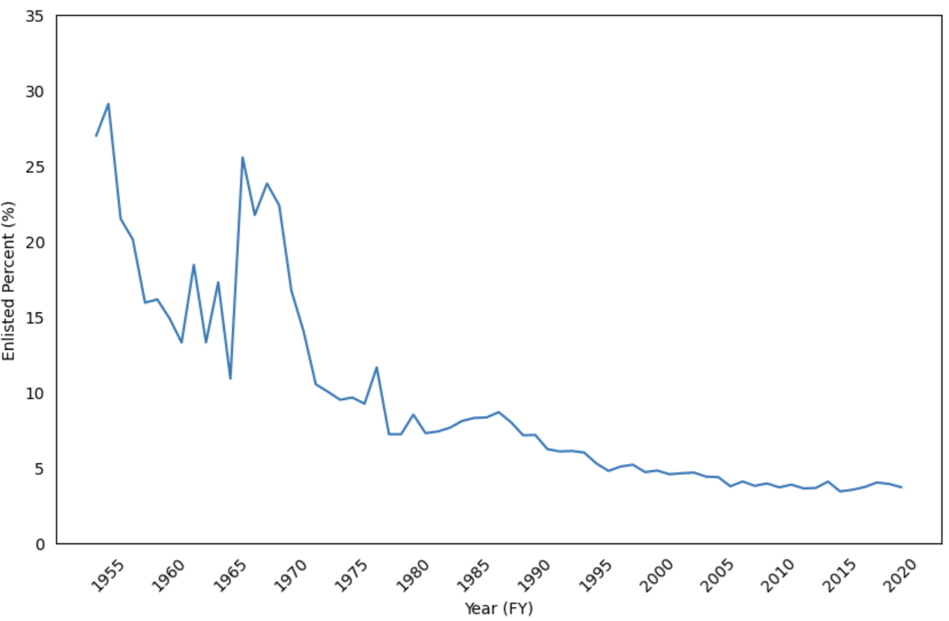
PERCENT ENLISTED ACCESSIONS US ARMED FORCES
AGE 18 , FY1954-2020
PQ1: What are the Enlisted Accession trends over time?

Slide 9
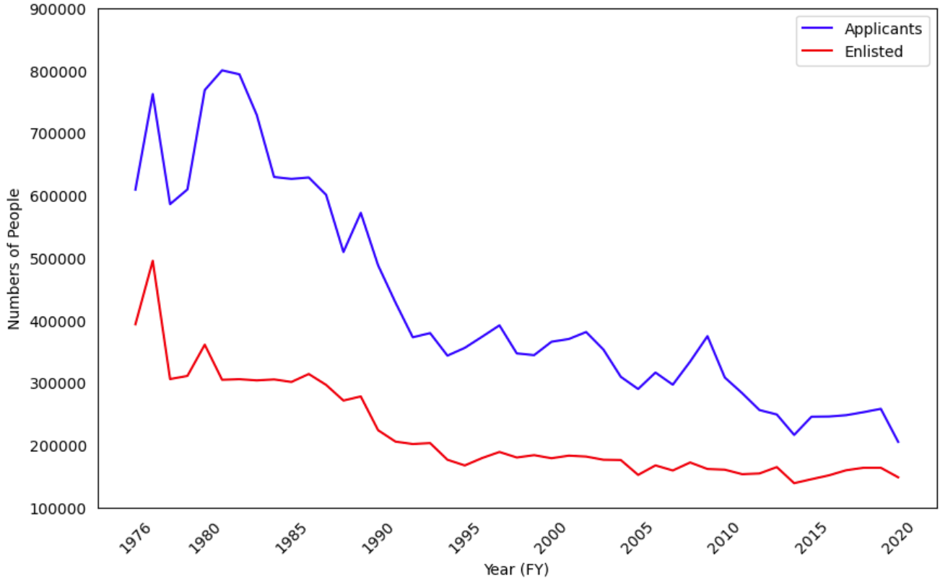
NUMBER OF APPLICANTS VS PEOPLE ENLISTING
IN THE US ARMED FORCES, FY1976-2020
PQ1: What are the Enlisted Accession trends over time?

Slide 10
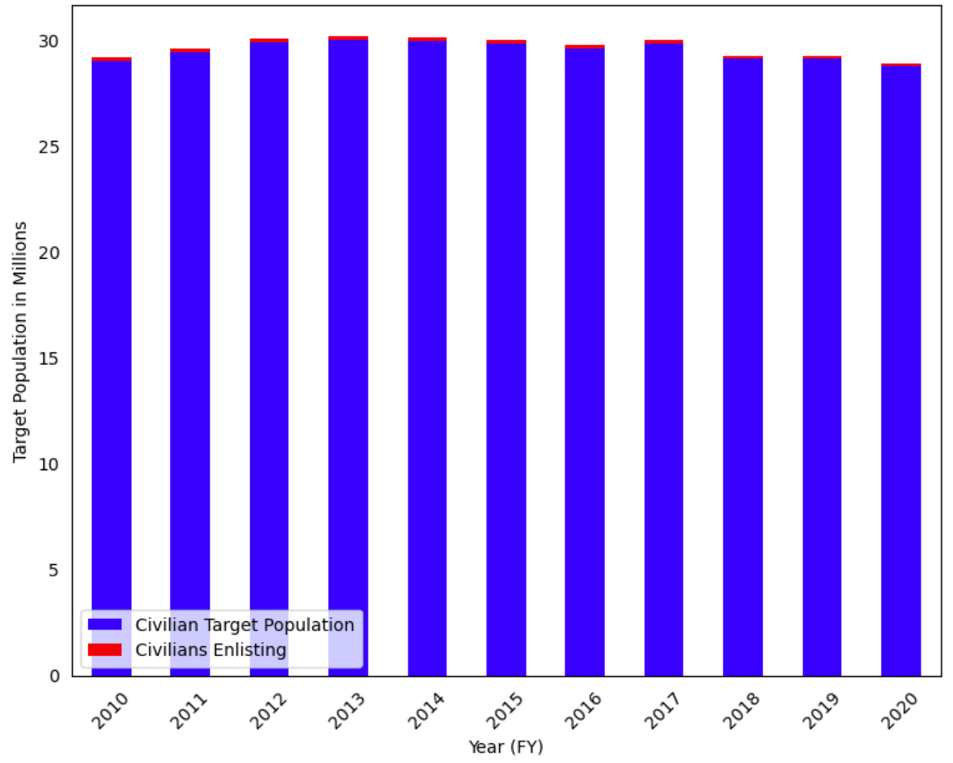
NUMBER OF CIVILANS AGED 18-24 VS THOSE ENLISTING IN THE US ARMED FORCES FY2010-2020
PQ1: What are the Enlisted Accession trends over time?

Slide 11
PROJECT FINDINGS 1
Enlisted Accessions have been decreasing over time.

Slide 12

PROJECT QUESTION 2
Are there areas where Enlisted Accessions differs from the population?

Slide 13
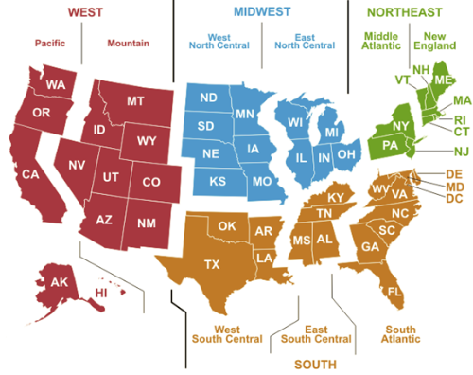
UNITED STATES CENSUS REGIONS AND DIVISIONS
Notes:
https://www.eia.gov/consumption/commercial/maps.php

Slide 14
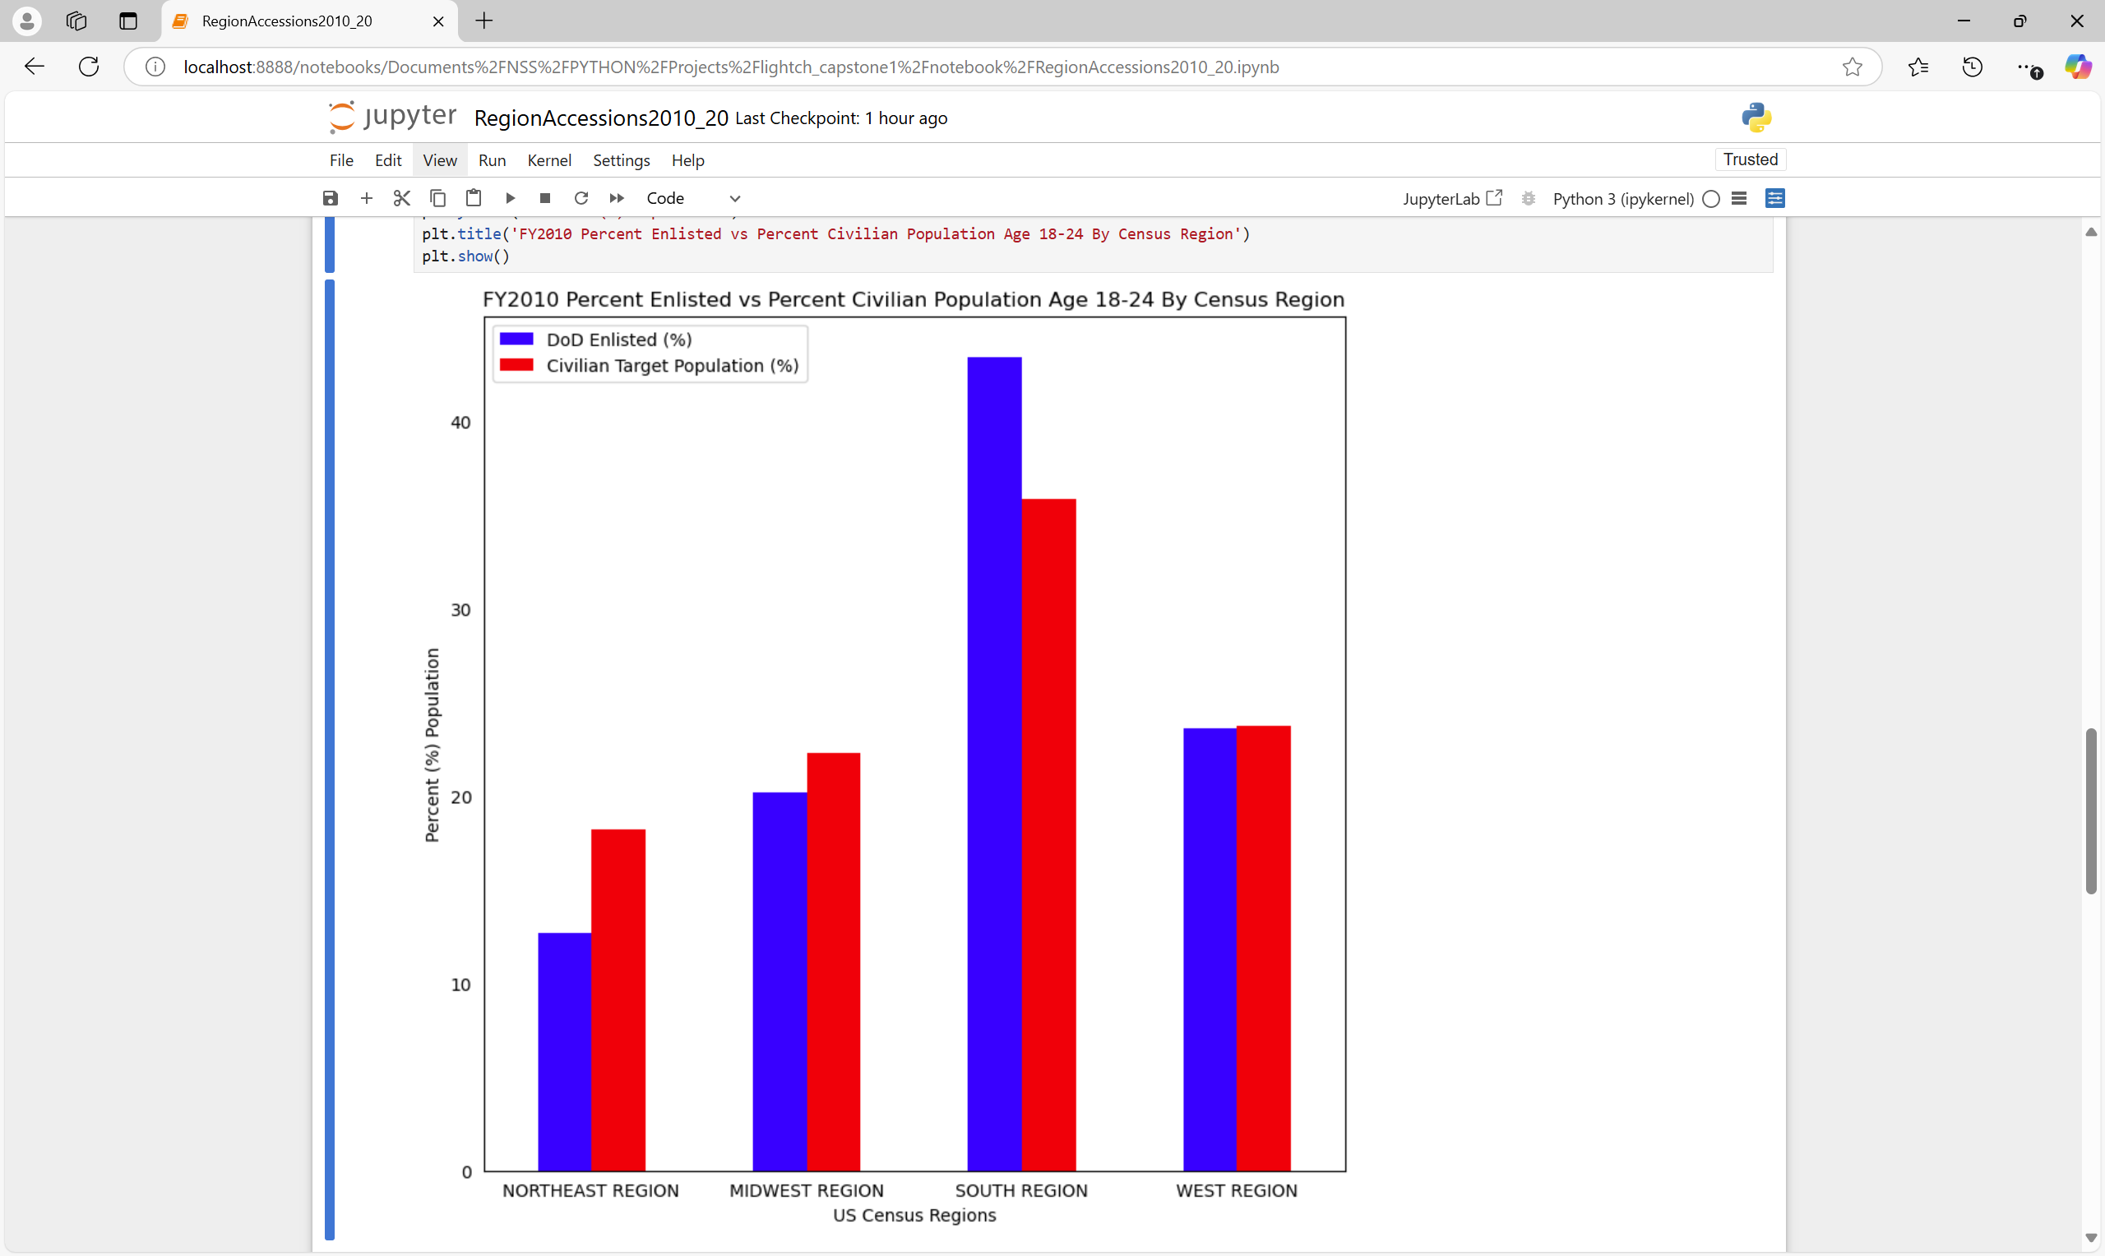
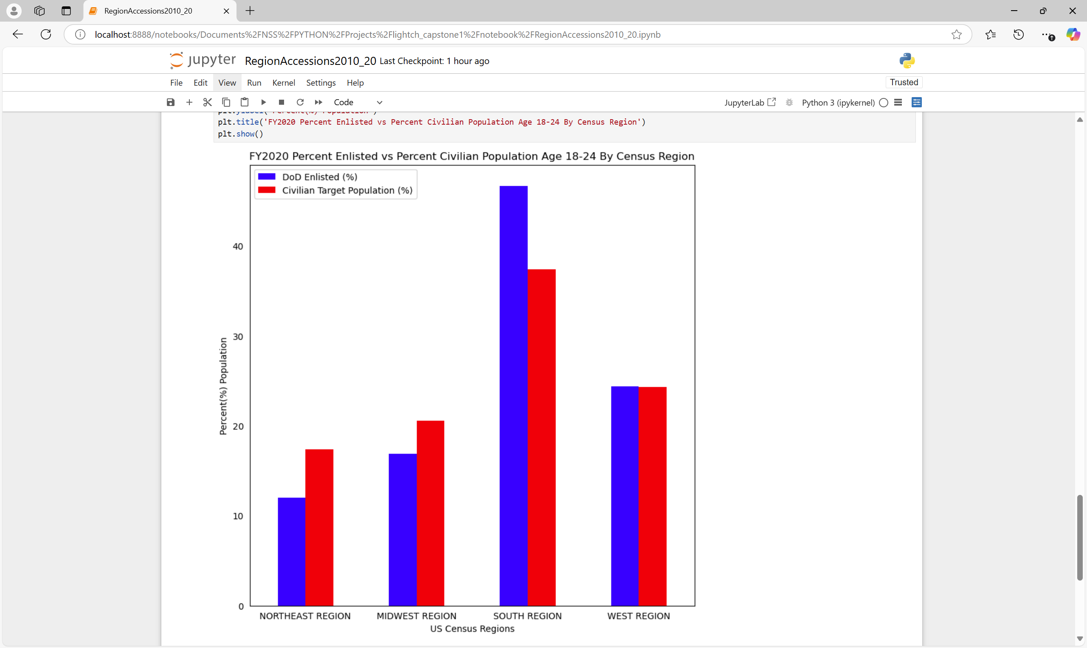
ENLISTED ACCESIONS FY2010 VS FY2020
BY REGION
PQ2: Are there areas
where Enlisted Accessions differs from the population?

Slide 15
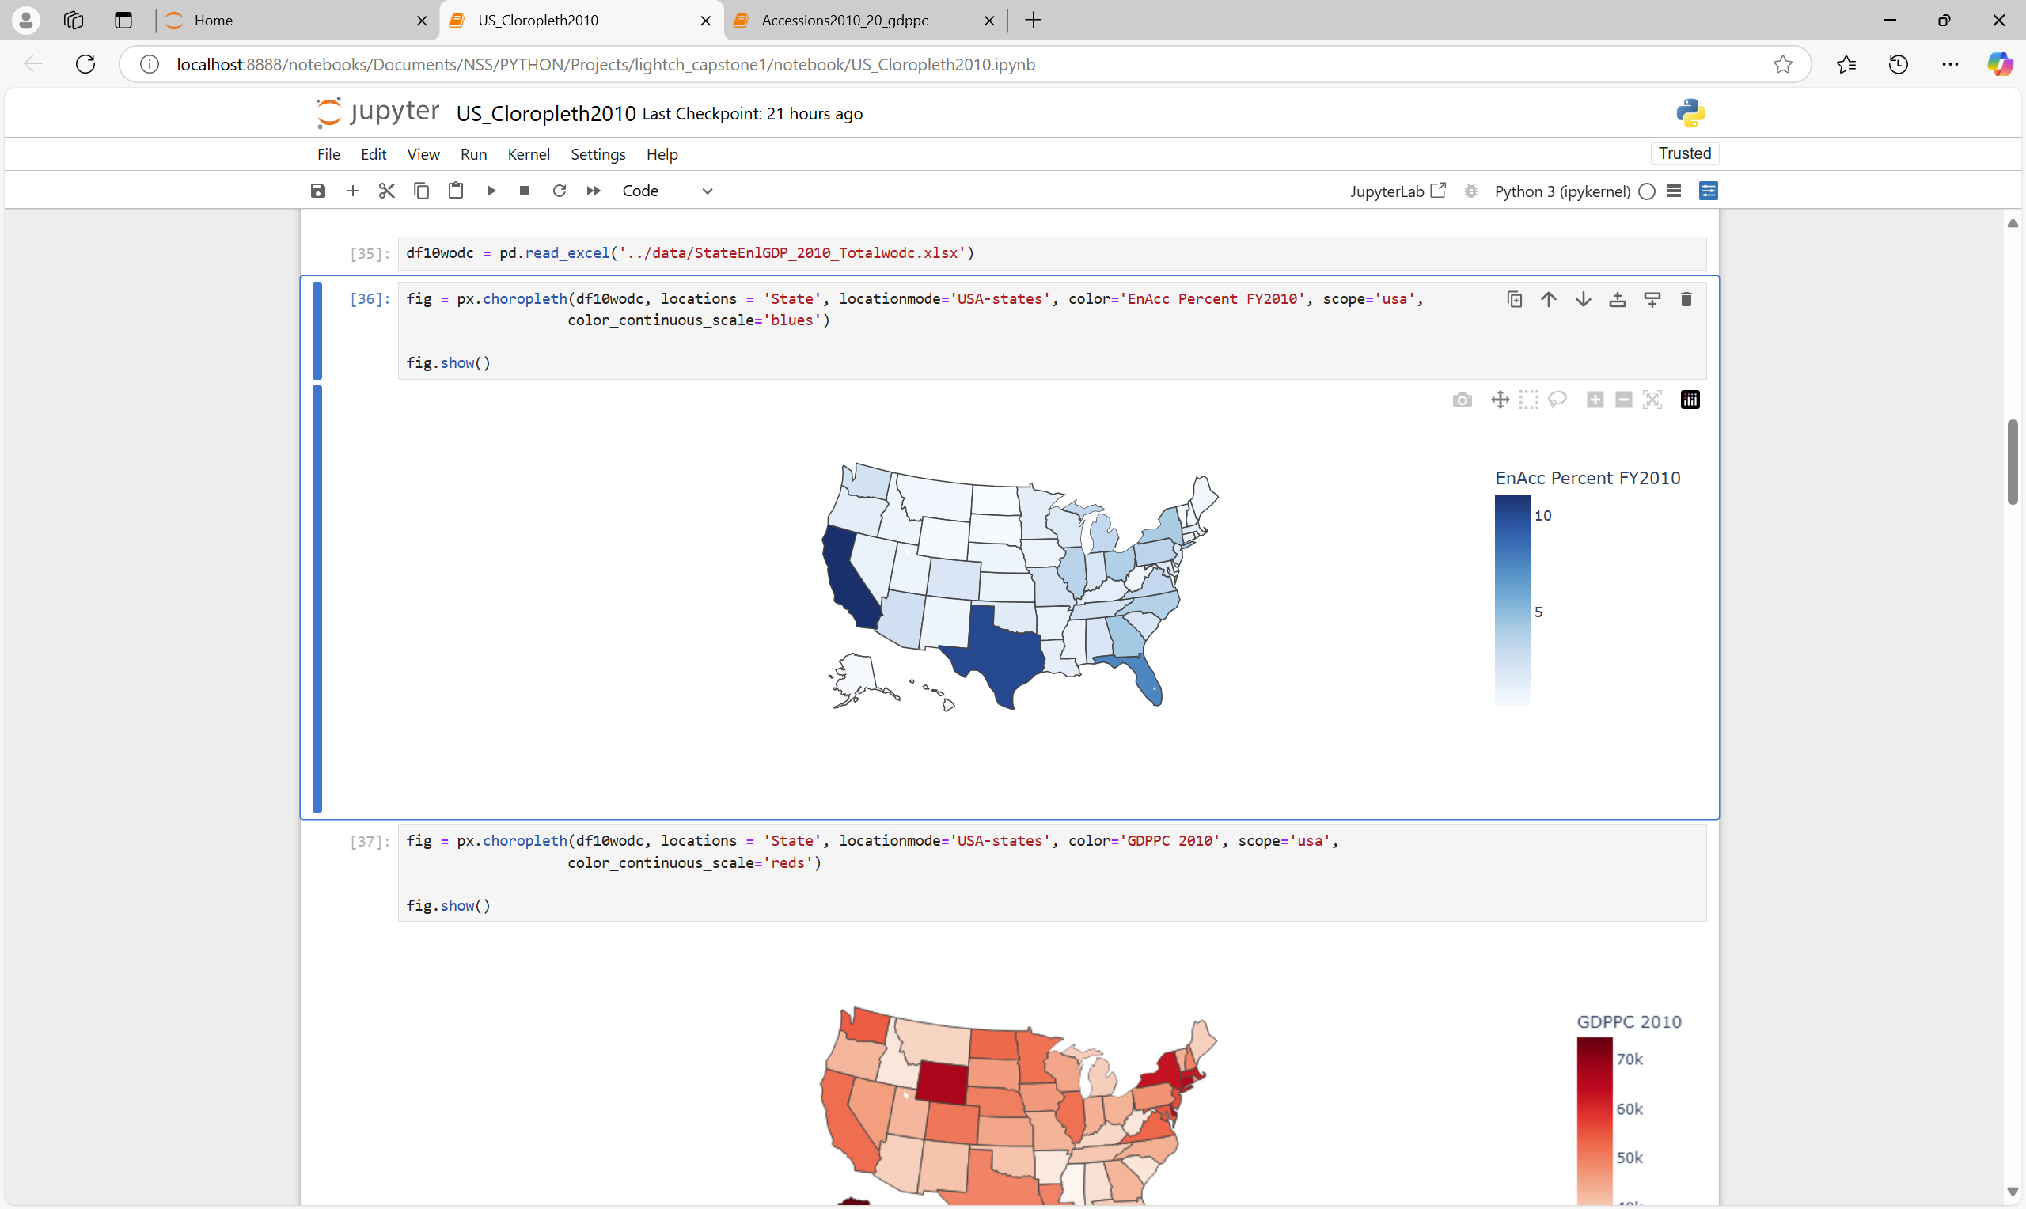
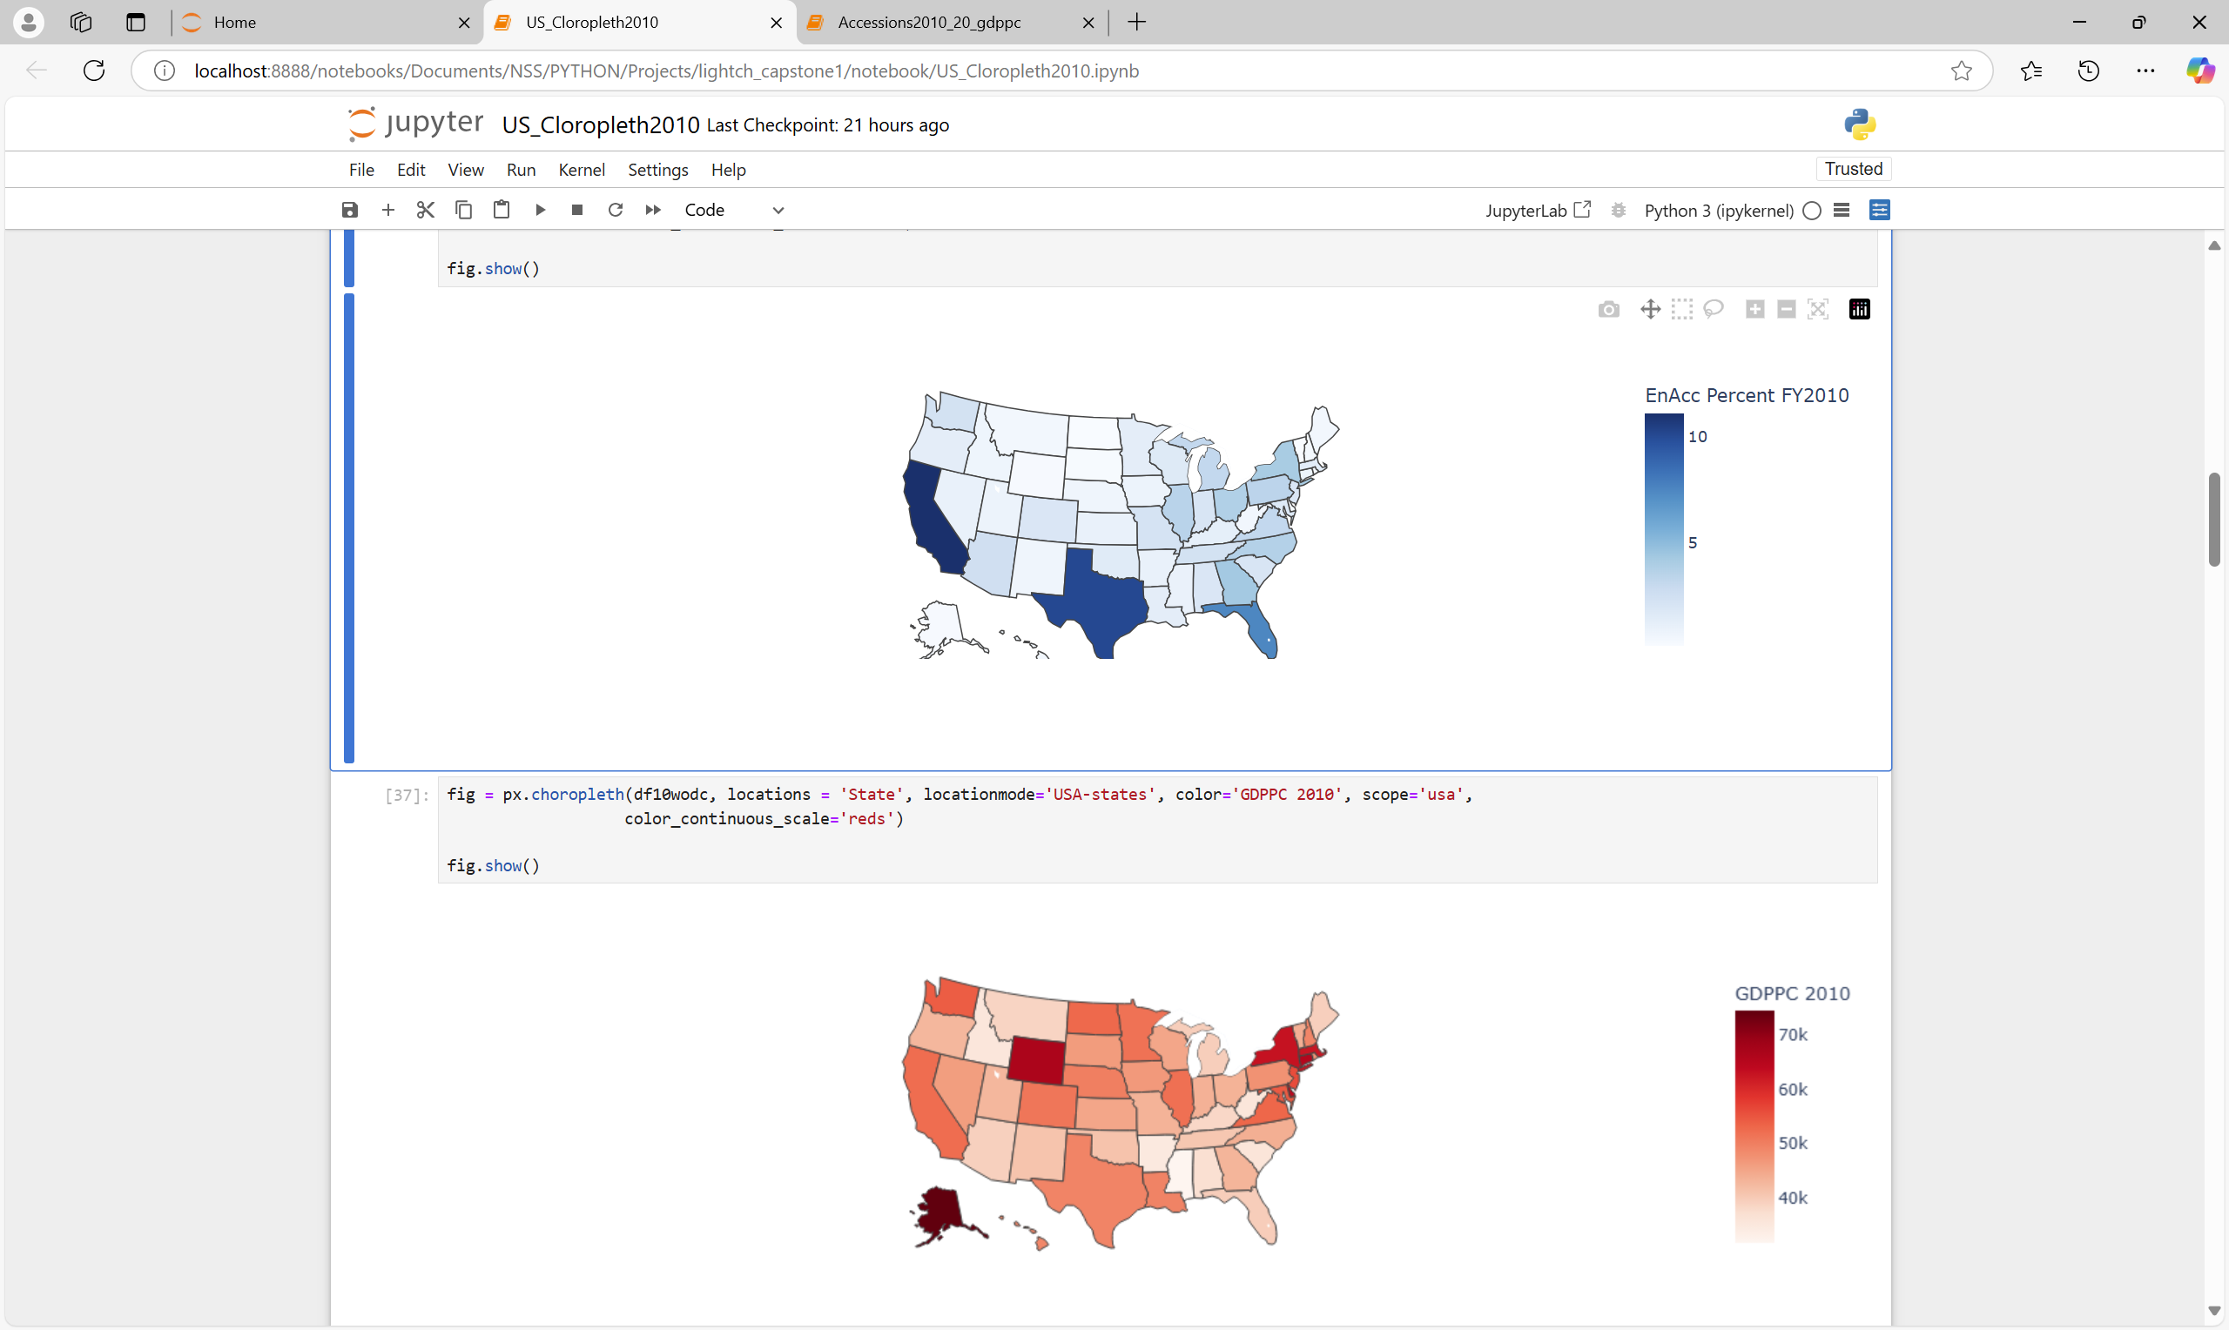
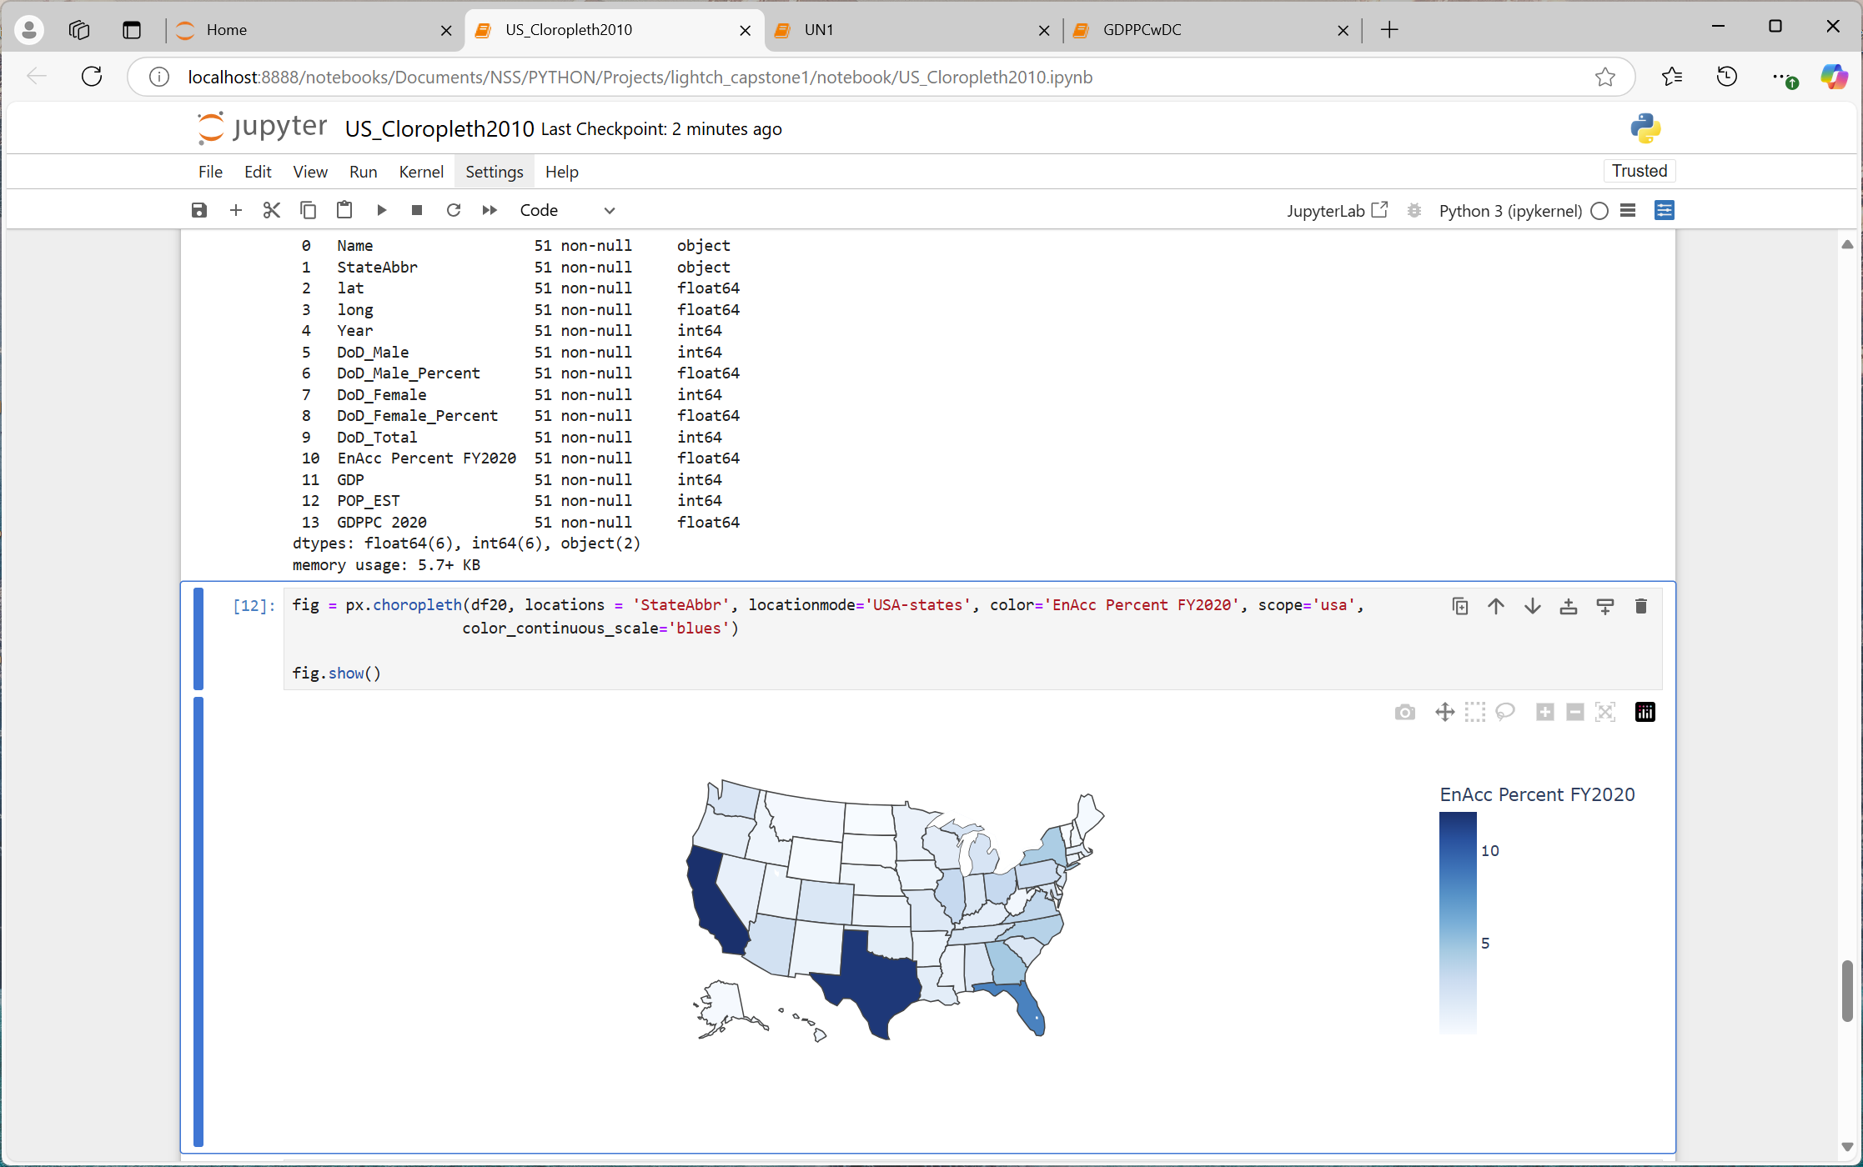
ENLISTED ACCESIONS FY2010 VS FY2020
PQ2: Are there areas
where Enlisted Accessions differs from the population?

Slide 16
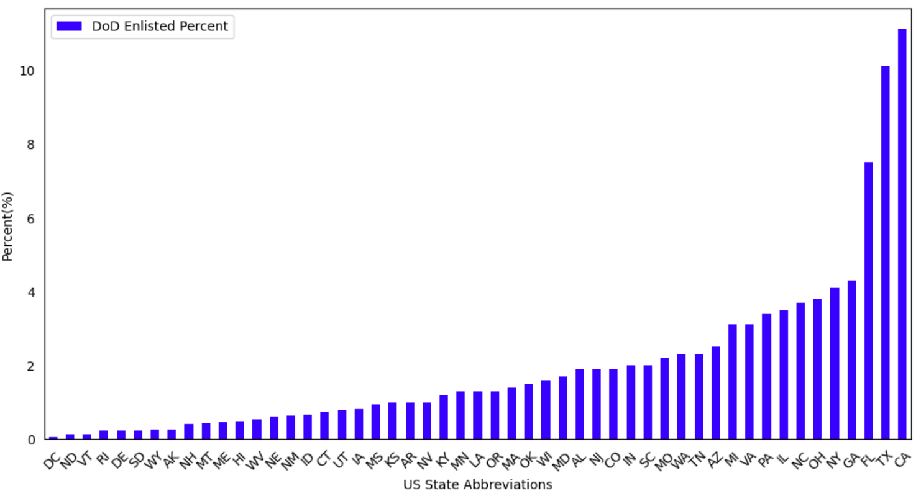
PERCENT ENLISTED ACCESSIONS BY STATE FY2010
TOP 10*
California | 11.10%
Texas | 10.10%
Florida | 7.50%
Georgia | 4.30%
New York | 4.10%
Ohio | 3.80%
North Carolina | 3.70%
Illinois | 3.50%
Pennsylvania | 3.40%
Michigan | 3.10%
Virginia | 3.10%
PQ2: Are there areas
where Enlisted Accessions differs from the population?

Slide 17
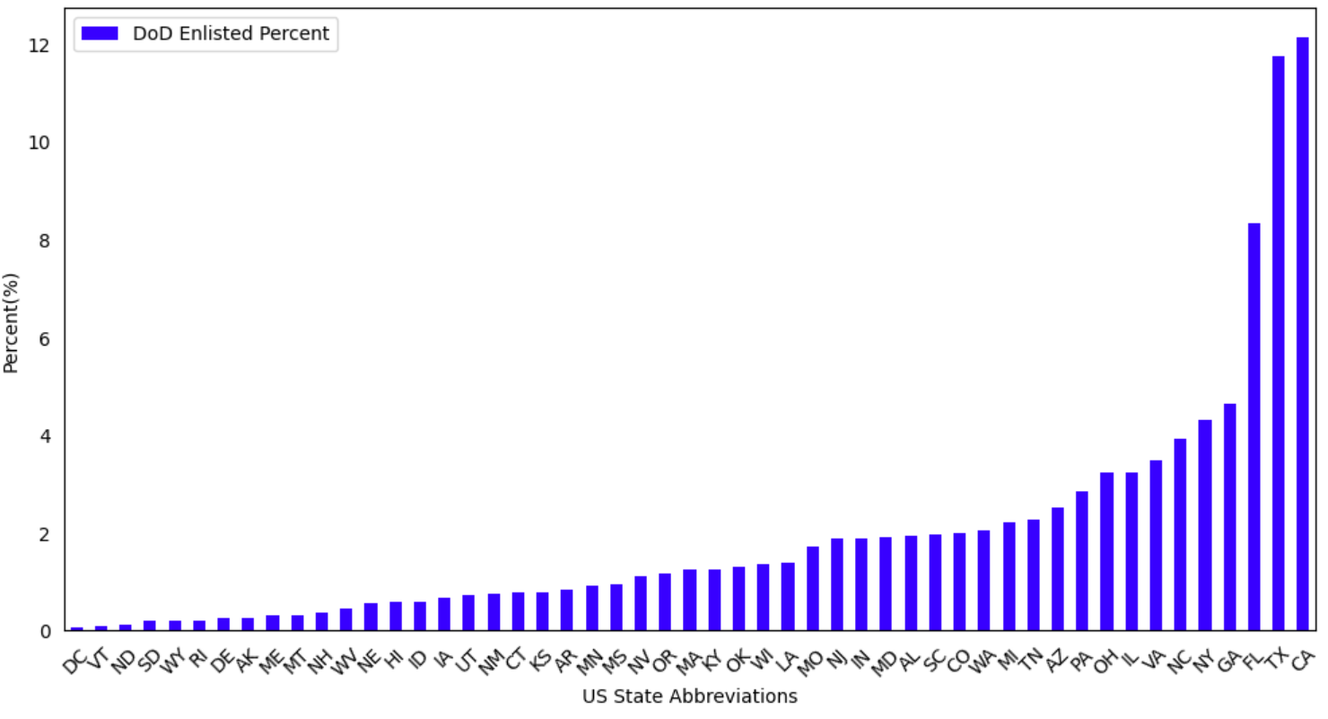
PERCENT ENLISTED ACCESSIONS BY STATE FY2020
TOP 10
California | 12.12%
Texas | 11.74%
Florida | 8.32%
Georgia | 4.63%
New York | 4.32%
North Carolina | 3.91%
Virginia | 3.47%
Illinois | 3.24%
Ohio | 3.23%
Pennsylvania | 2.85%
PQ2: Are there areas
where Enlisted Accessions differs from the population?

Slide 18
PROJECT FINDINGS 2
Across FY2010-2020, the SOUTH Region is where the percent of enlisted accessions exceeds the percent of the region’s target population.
The NORTHEAST and MIDWEST Regions were where the percent of enlisted accessions were lower than the percent of the region’s target population.
In the WEST Region, the percent of enlisted accessions was on par with the region’s target population.

Slide 19

PROJECT QUESTION 3
Is there a relationship between GDP Per Capita and percent Enlisted Accessions?

Slide 20
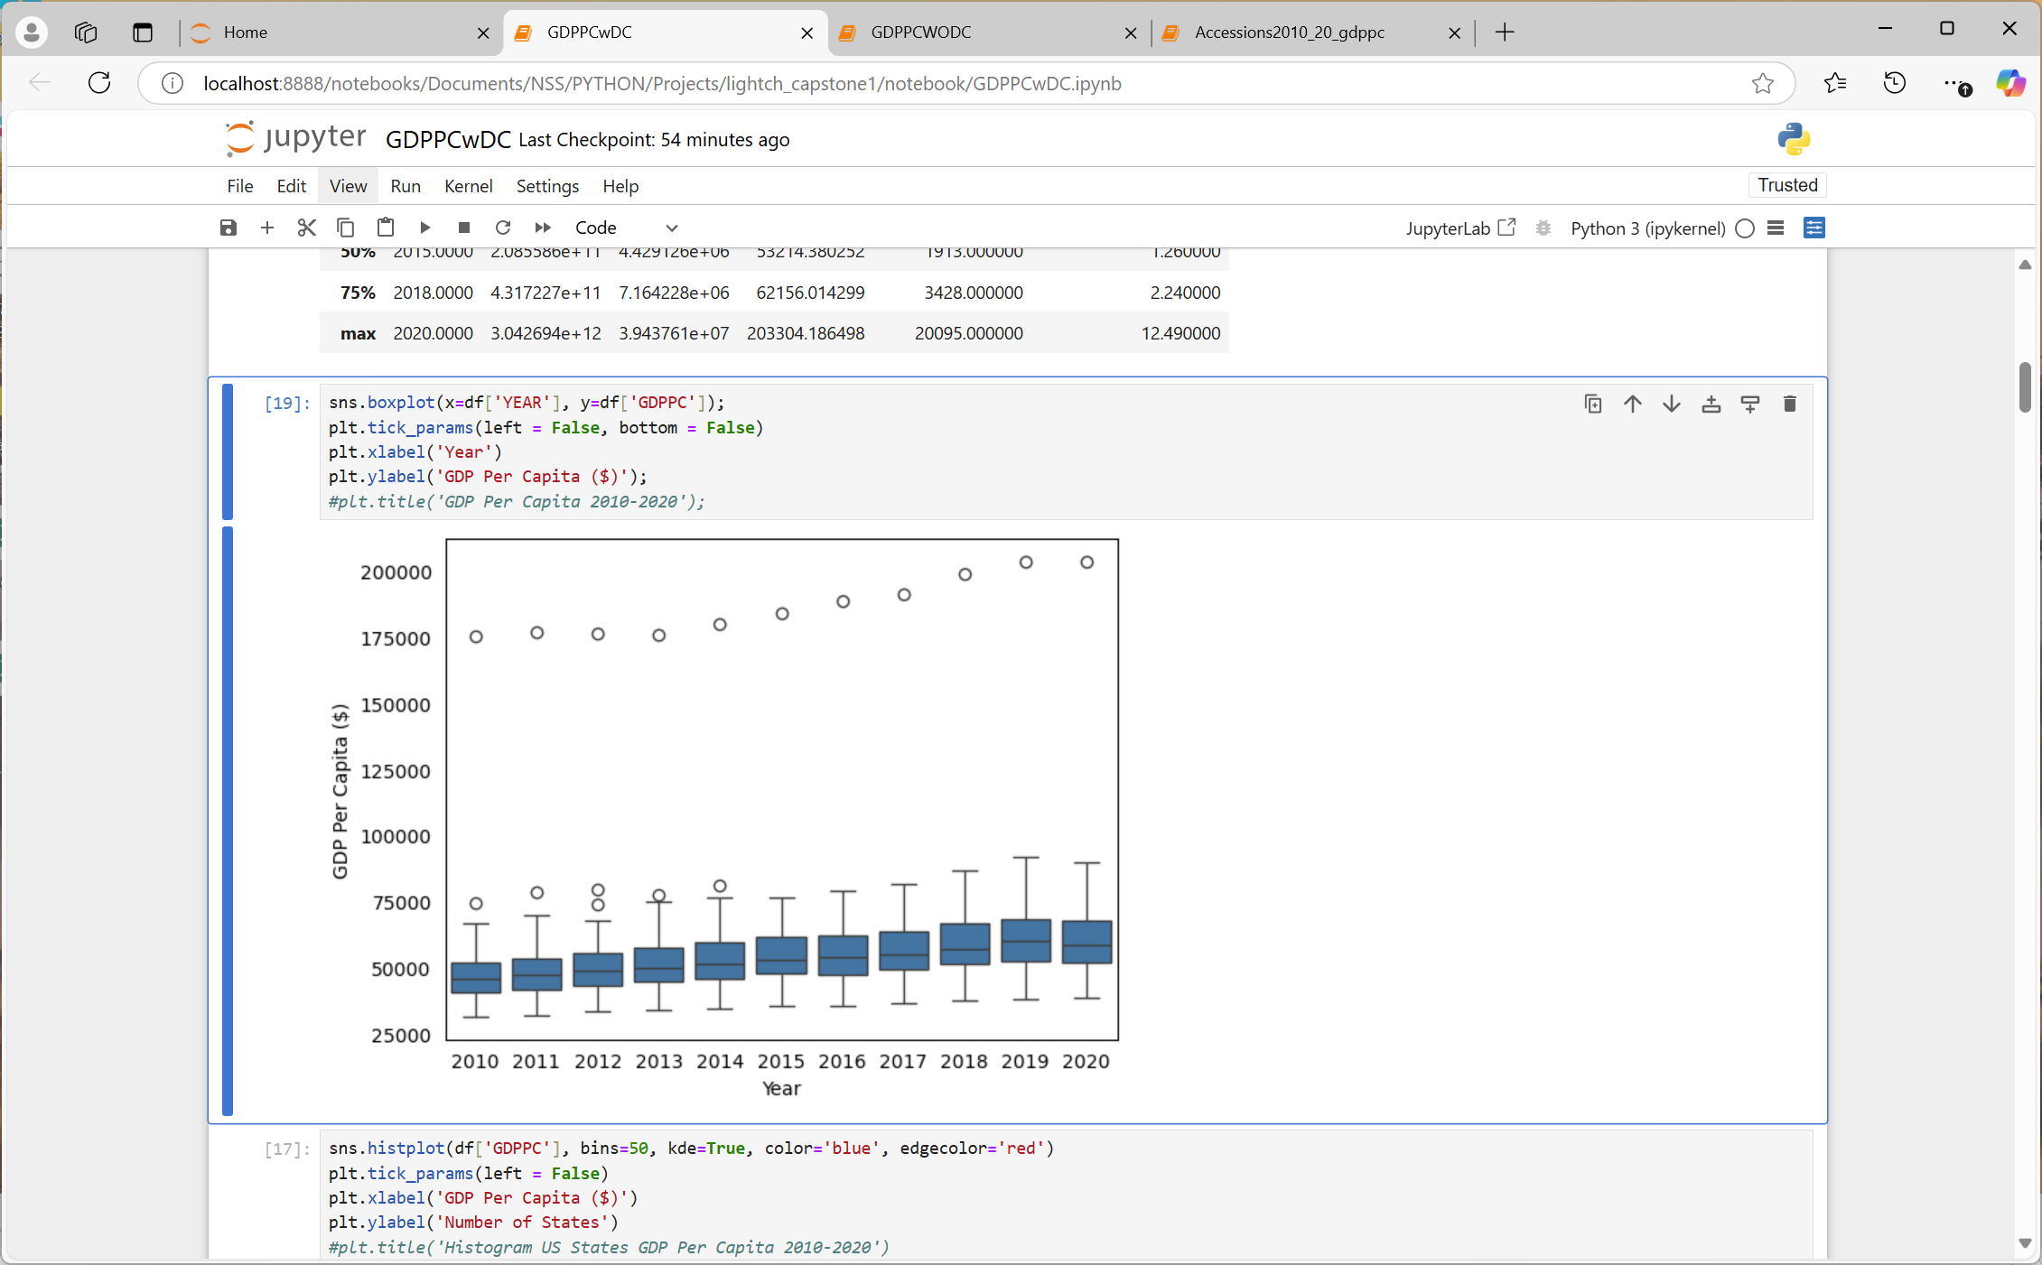
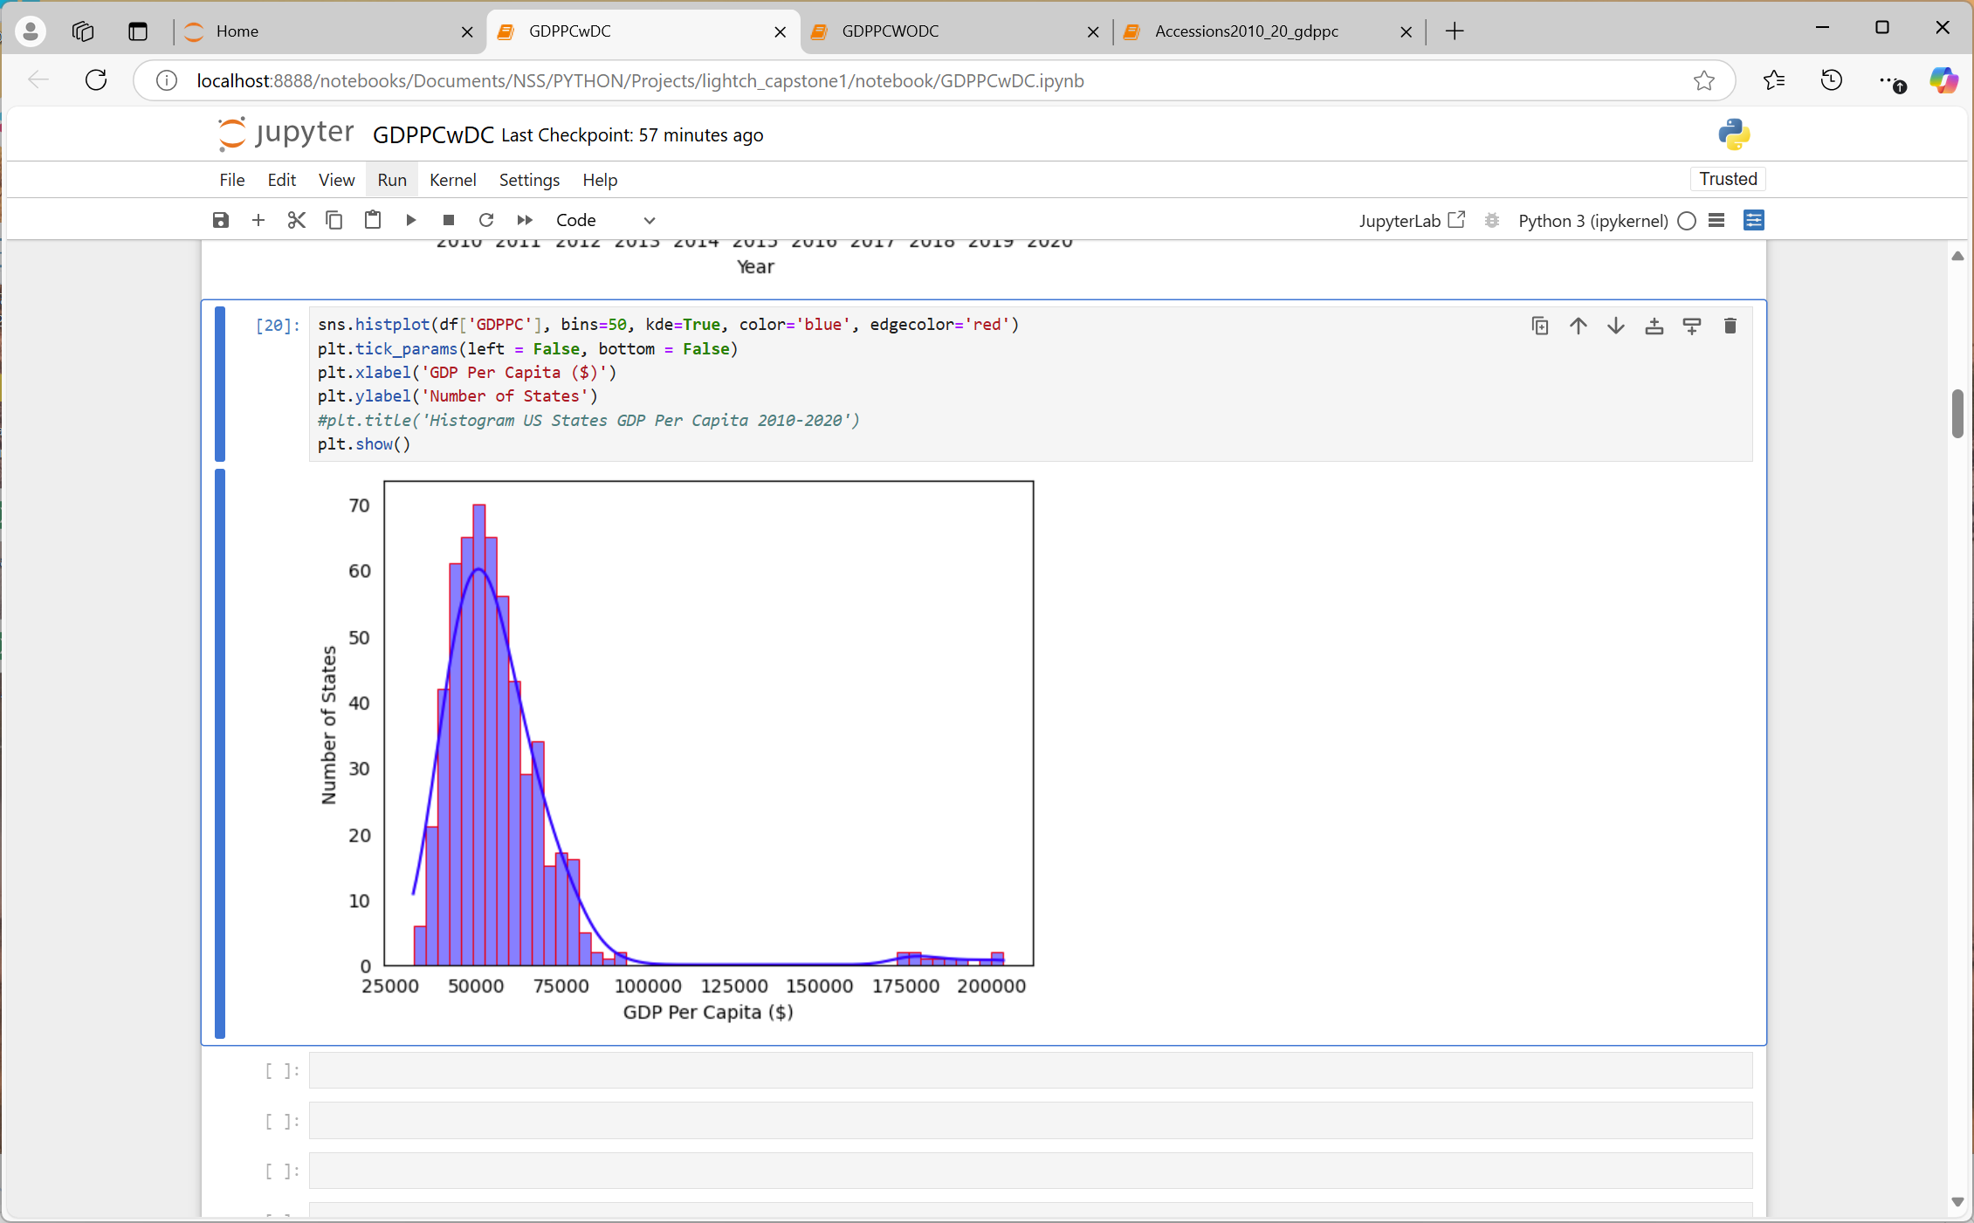
US GDP PER CAPITA 2010-2020
PQ3: Is there a relationship between GDP Per Capita and Enlisted Accessions?

Slide 21
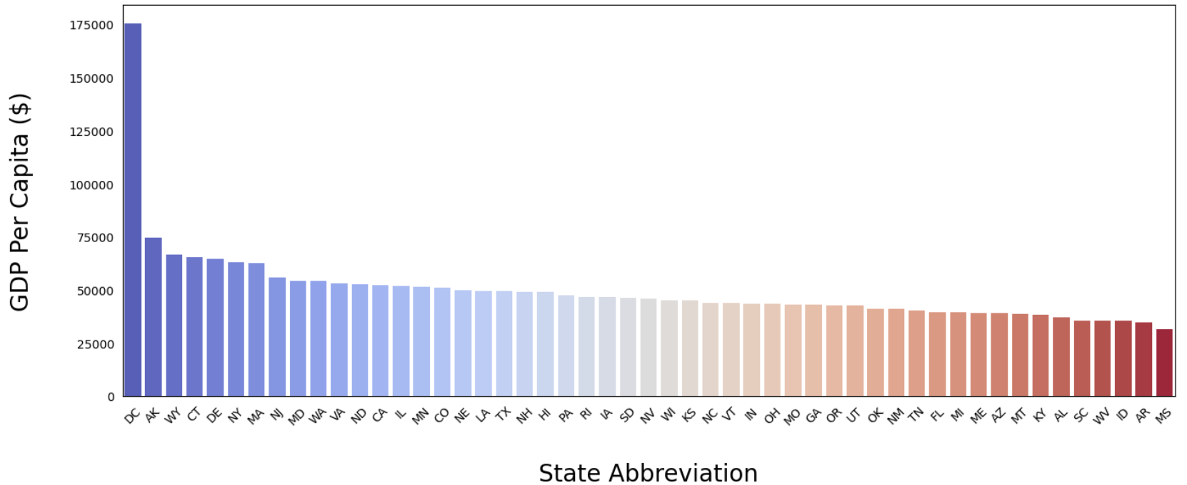
GDP PER CAPITA BY STATE 2010
PQ3: Is there a relationship between GDP Per Capita and Enlisted Accessions?
2010 US Mean (Average) GDPPC $49,710
Highest GDPPC: Washington DC $175,367
Lowest GDPPC: Mississippi $31,624
Median GDPPC: Nevada $46,131

Slide 22
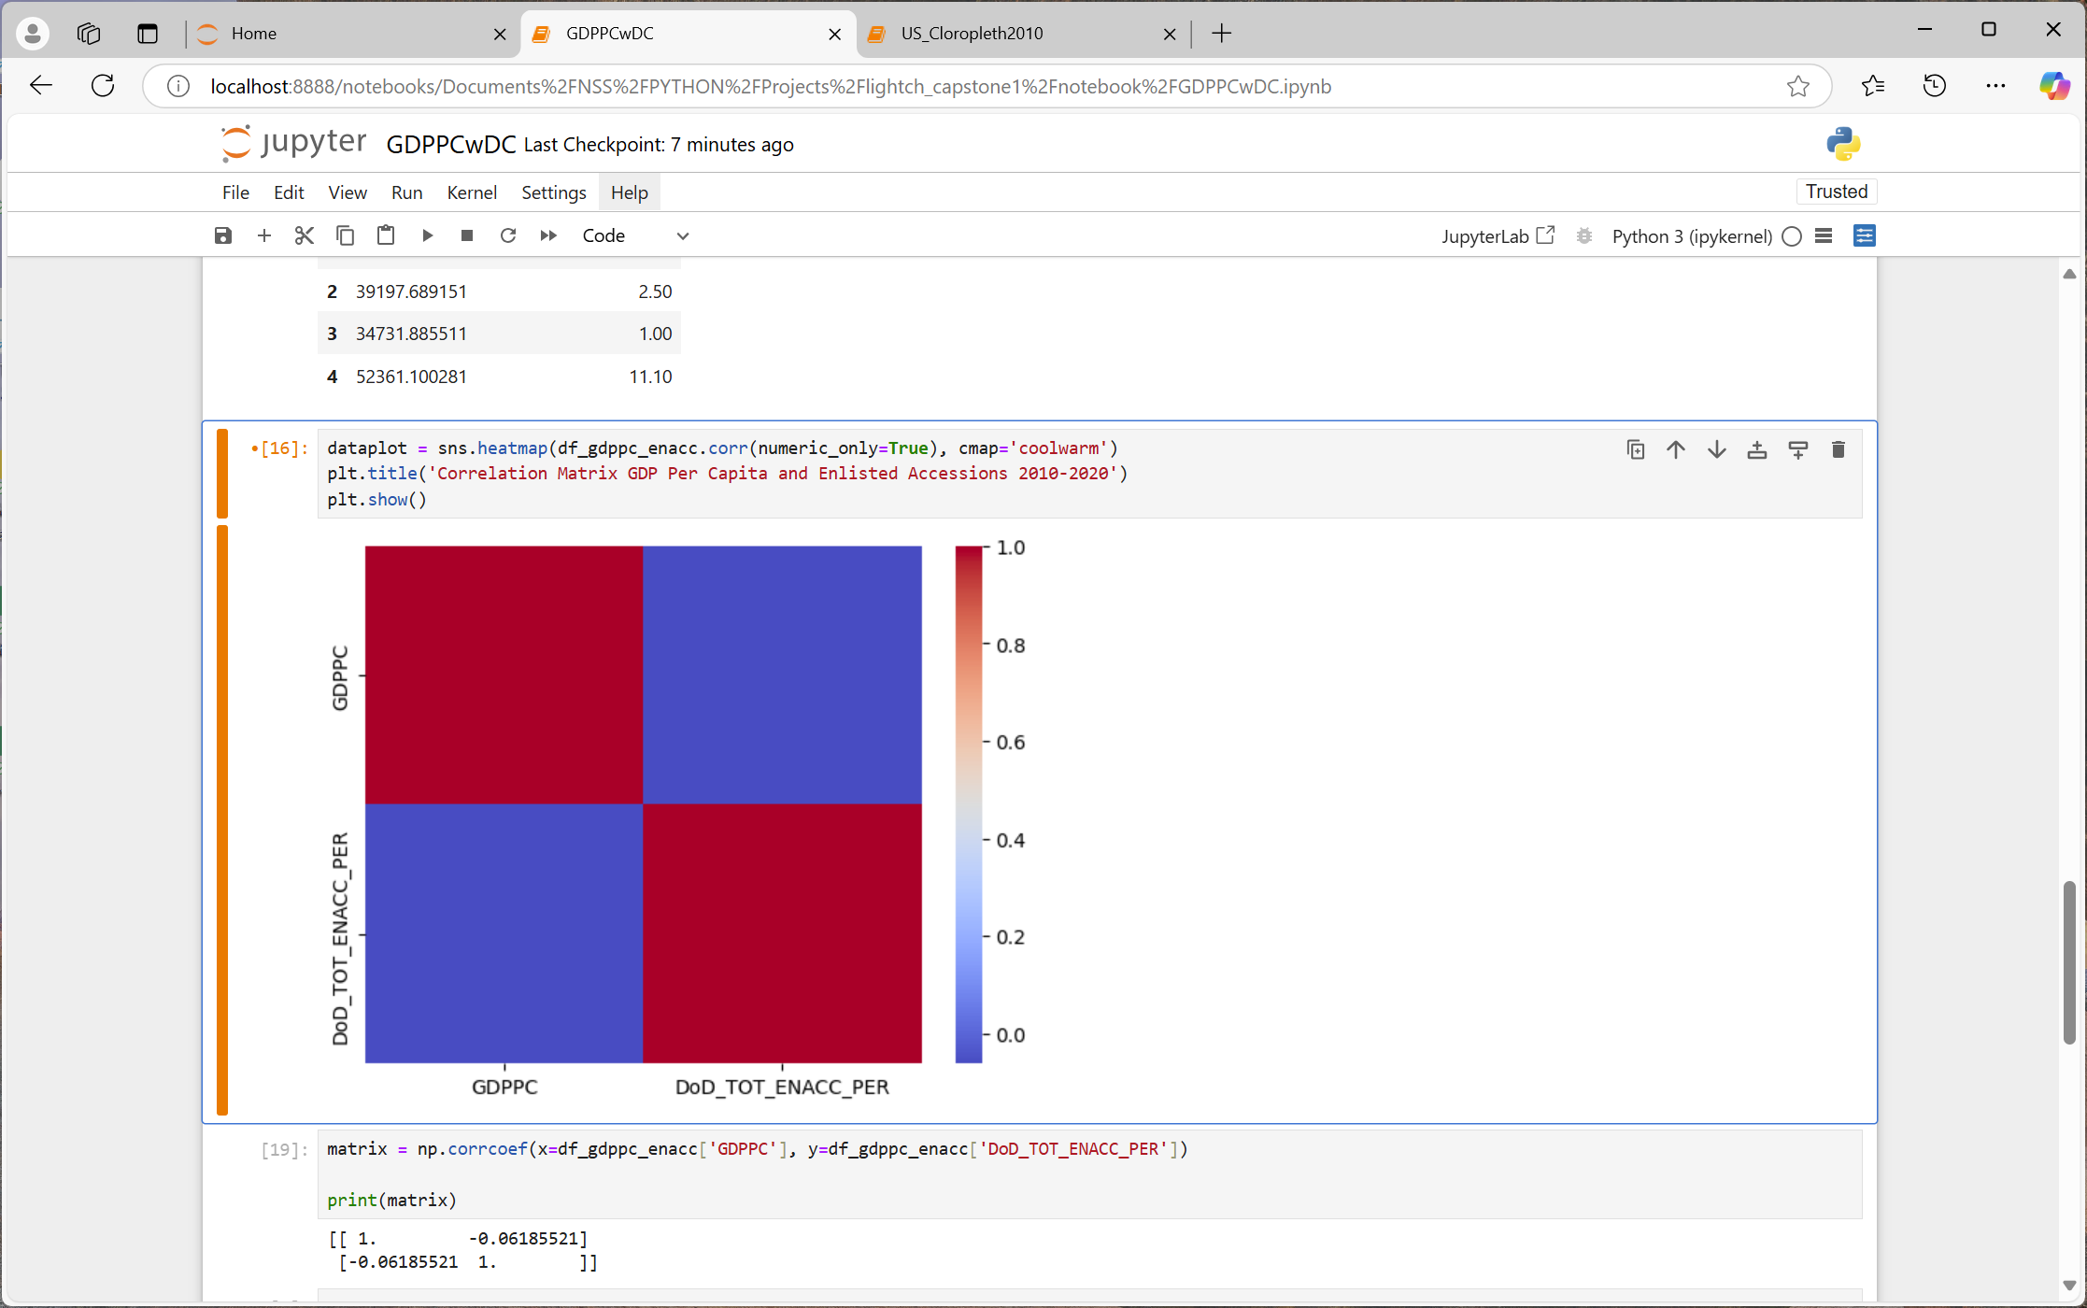
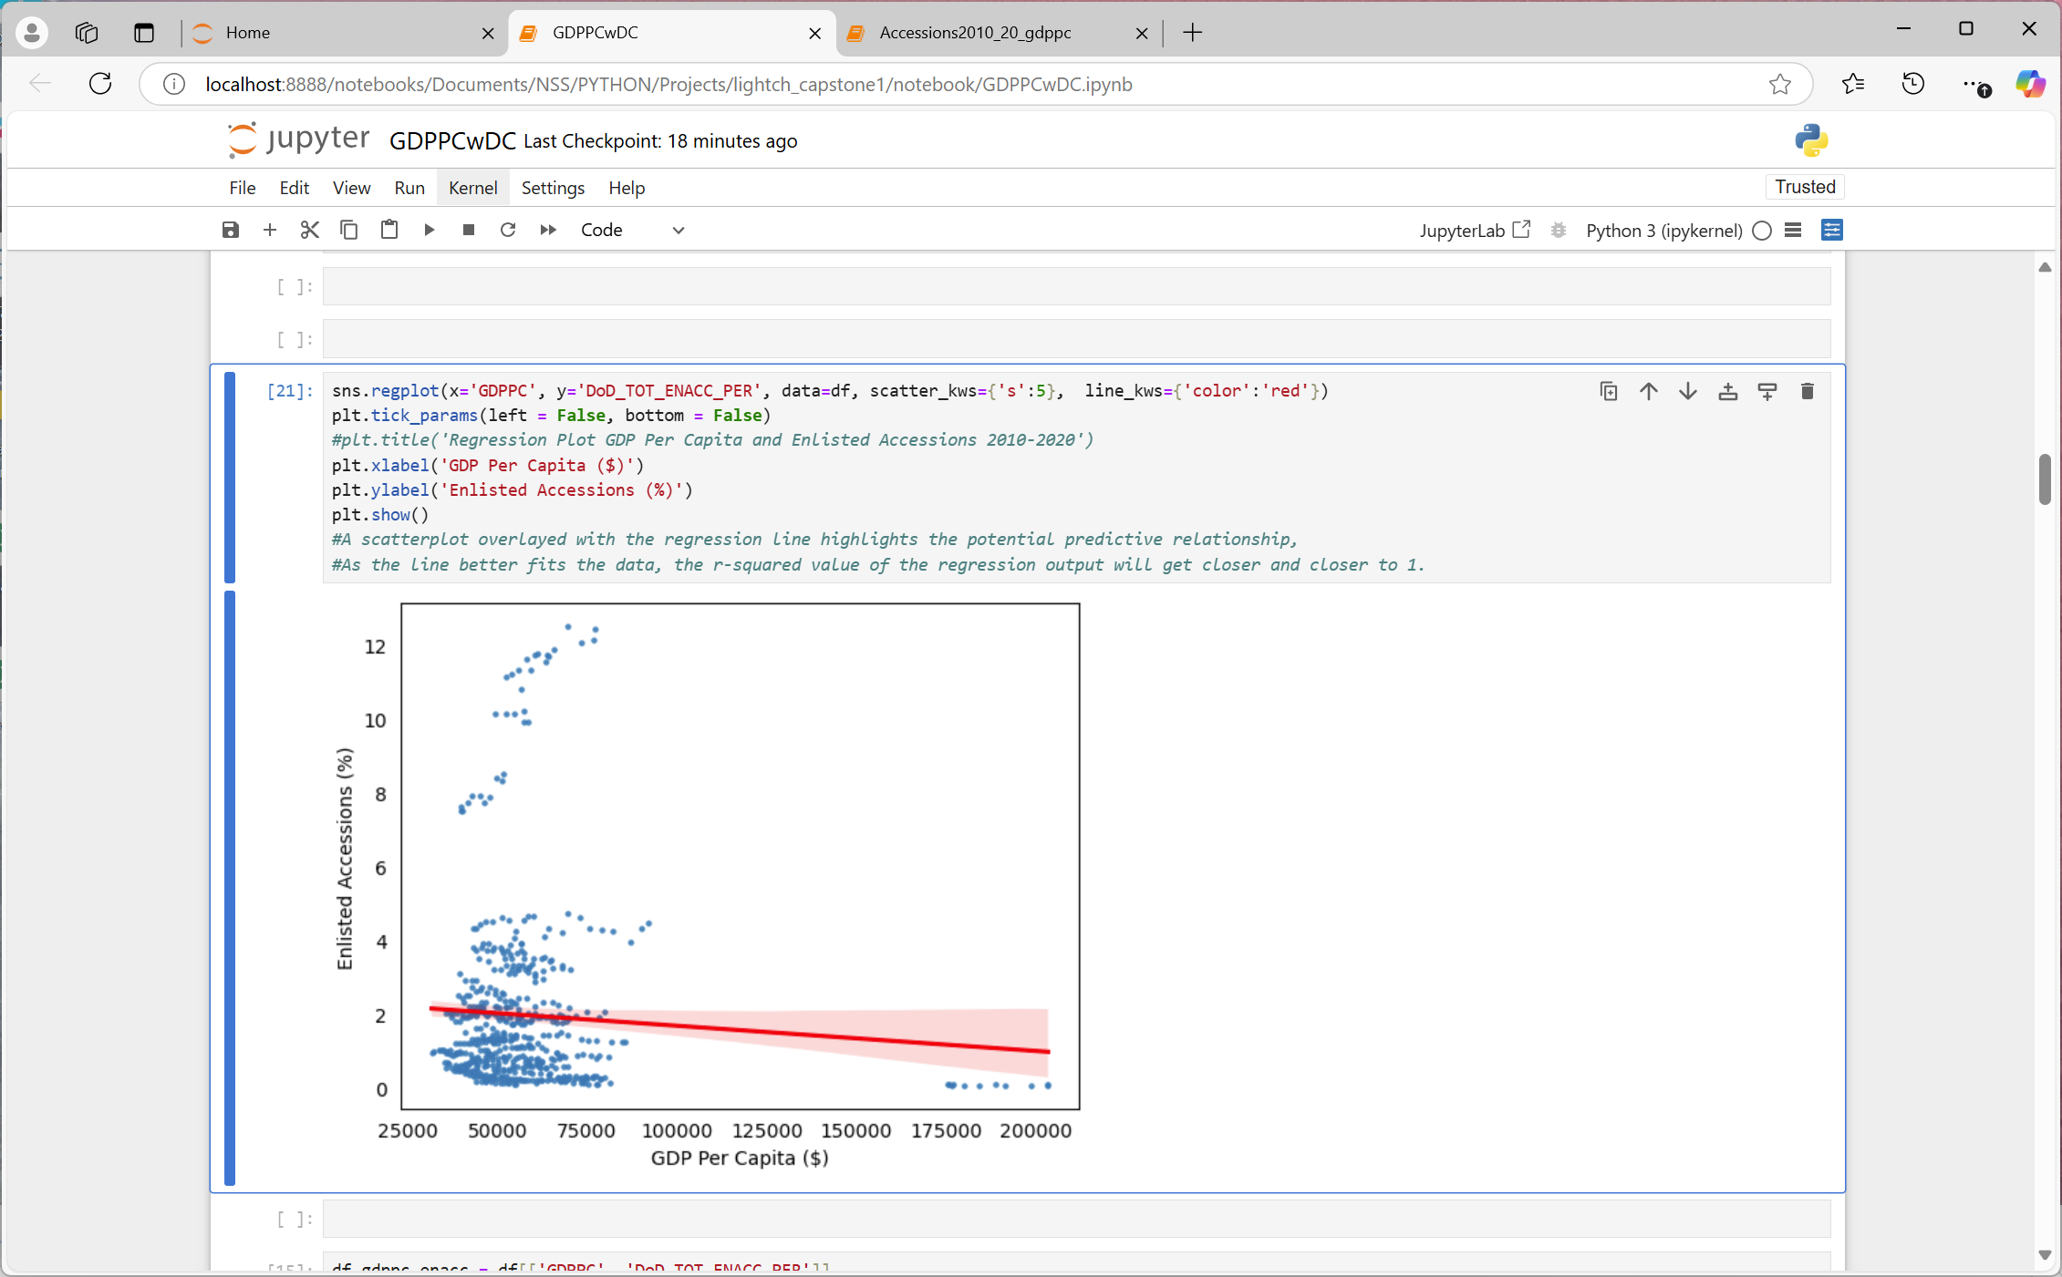
GDP PER CAPITA & PERCENT ENLISTED ACCESSIONS 2010-2020
PQ3: Is there a relationship between GDP Per Capita and Enlisted Accessions?
1 | -0.0619
-0.0619 | 1

Slide 23
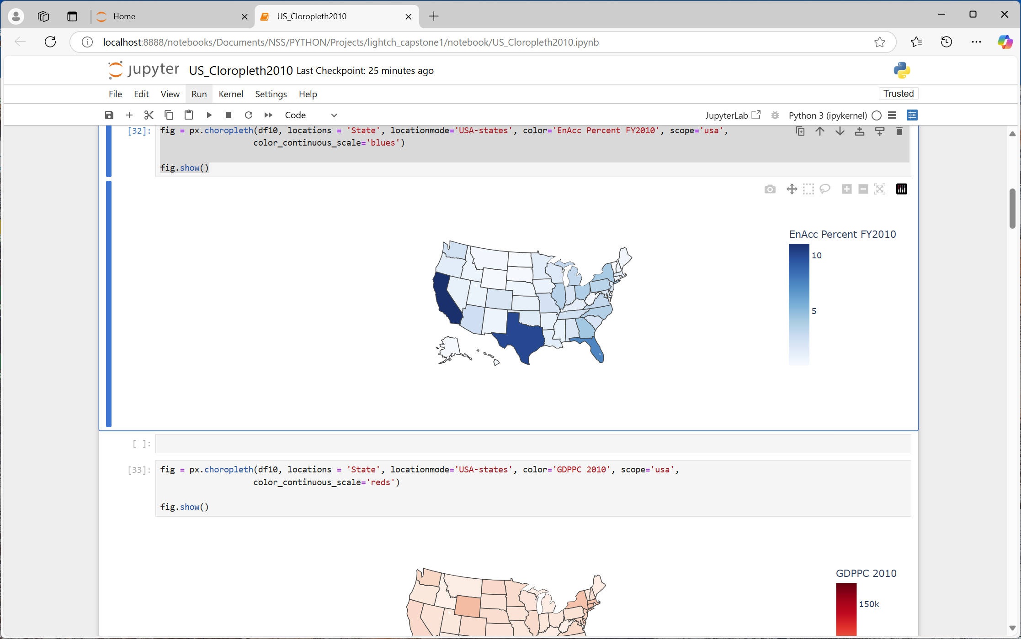
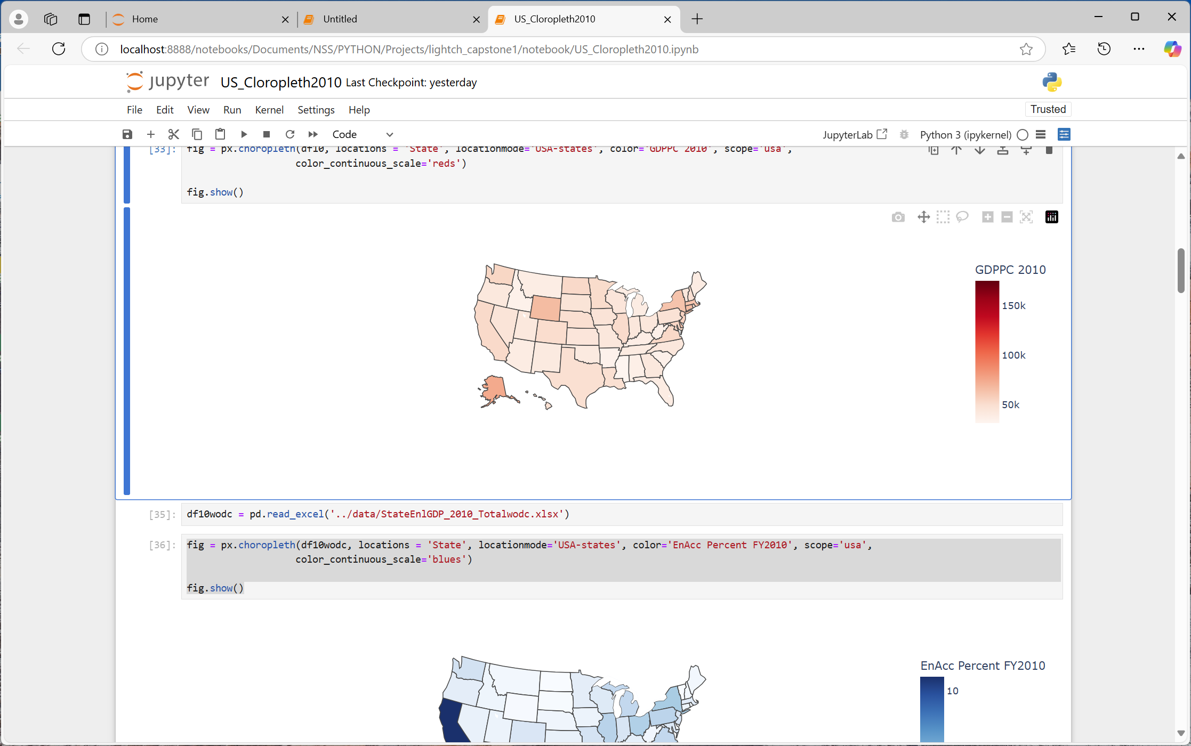
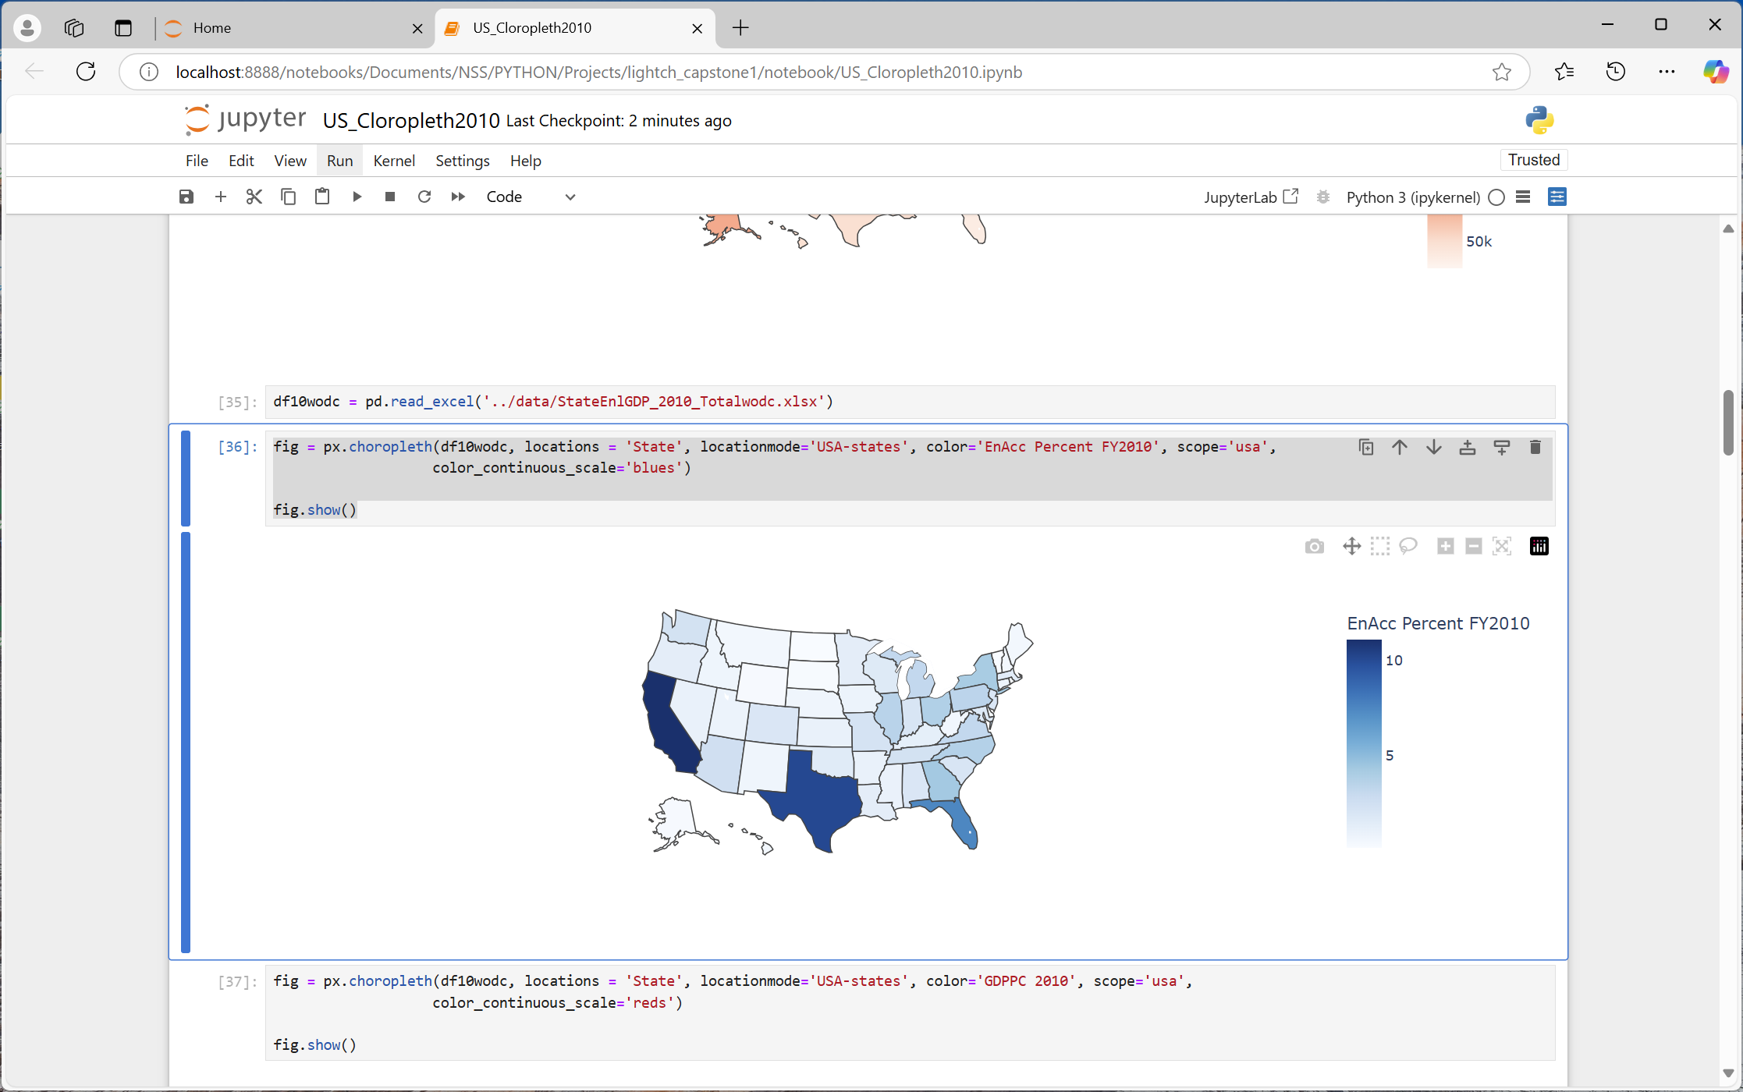
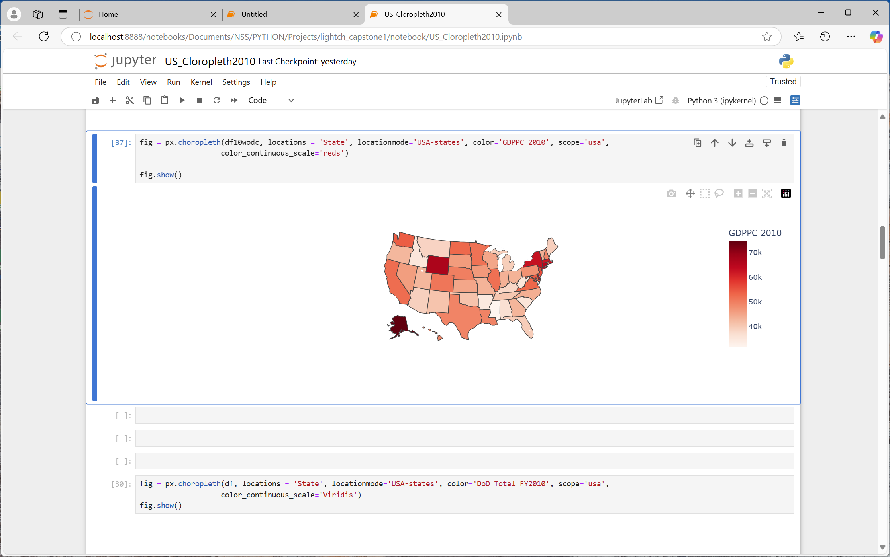
METHODOLOGY NOTE (2010)
WITH DC
WITHOUT DC

Slide 24
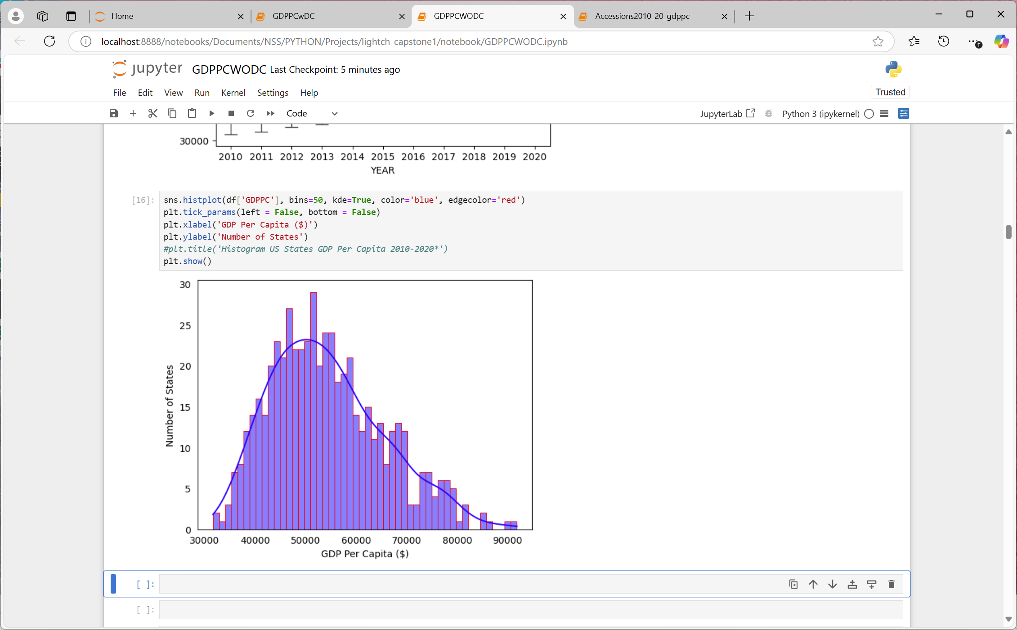
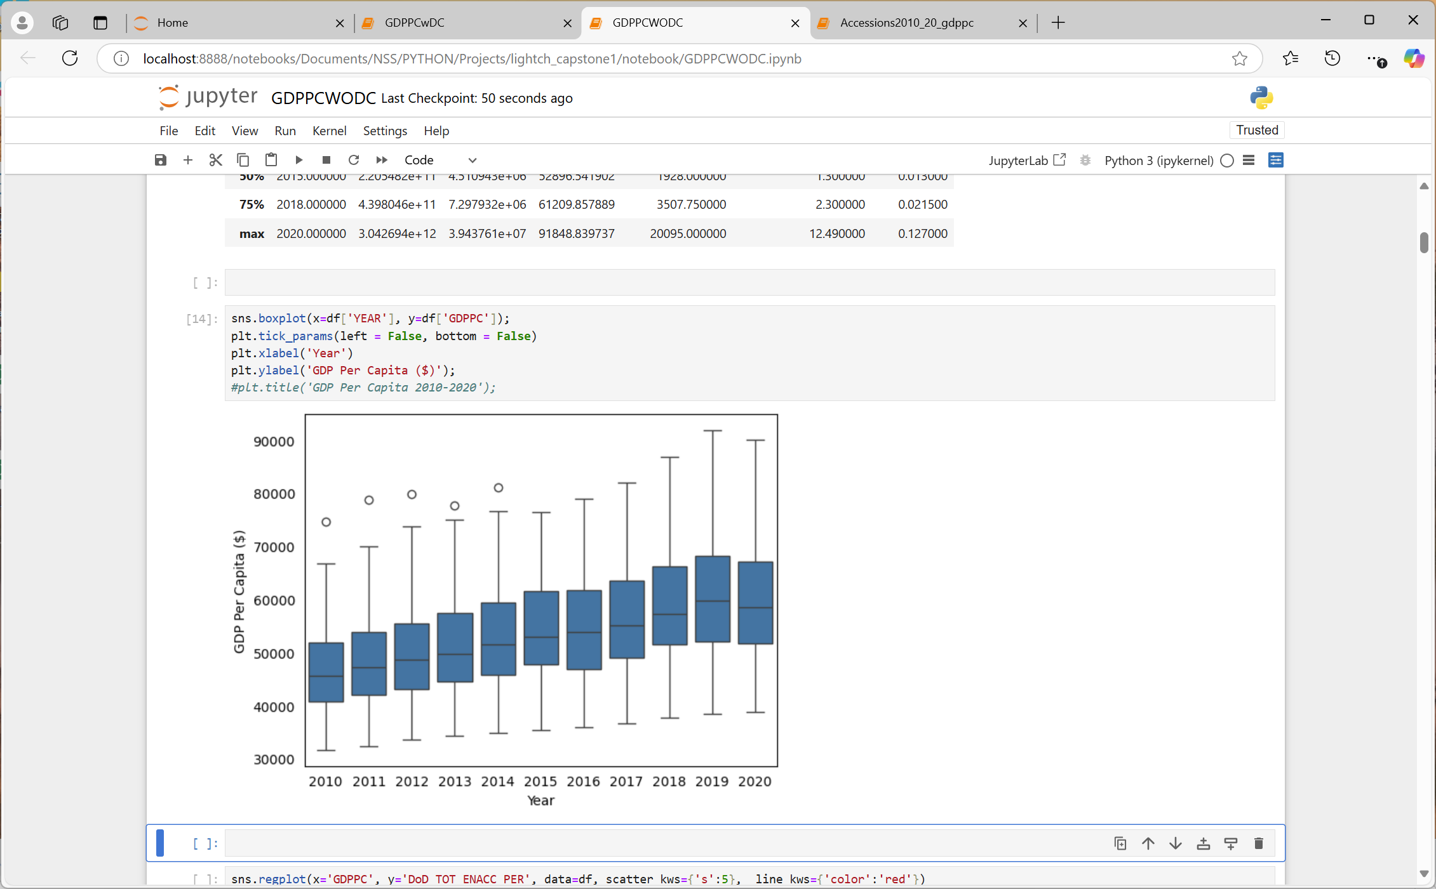
US GDP PER CAPITA 2010-2020*
PQ3: Is there a relationship between GDP Per Capita and Enlisted Accessions?
*Washington DC removed –bottom graphs

Slide 25
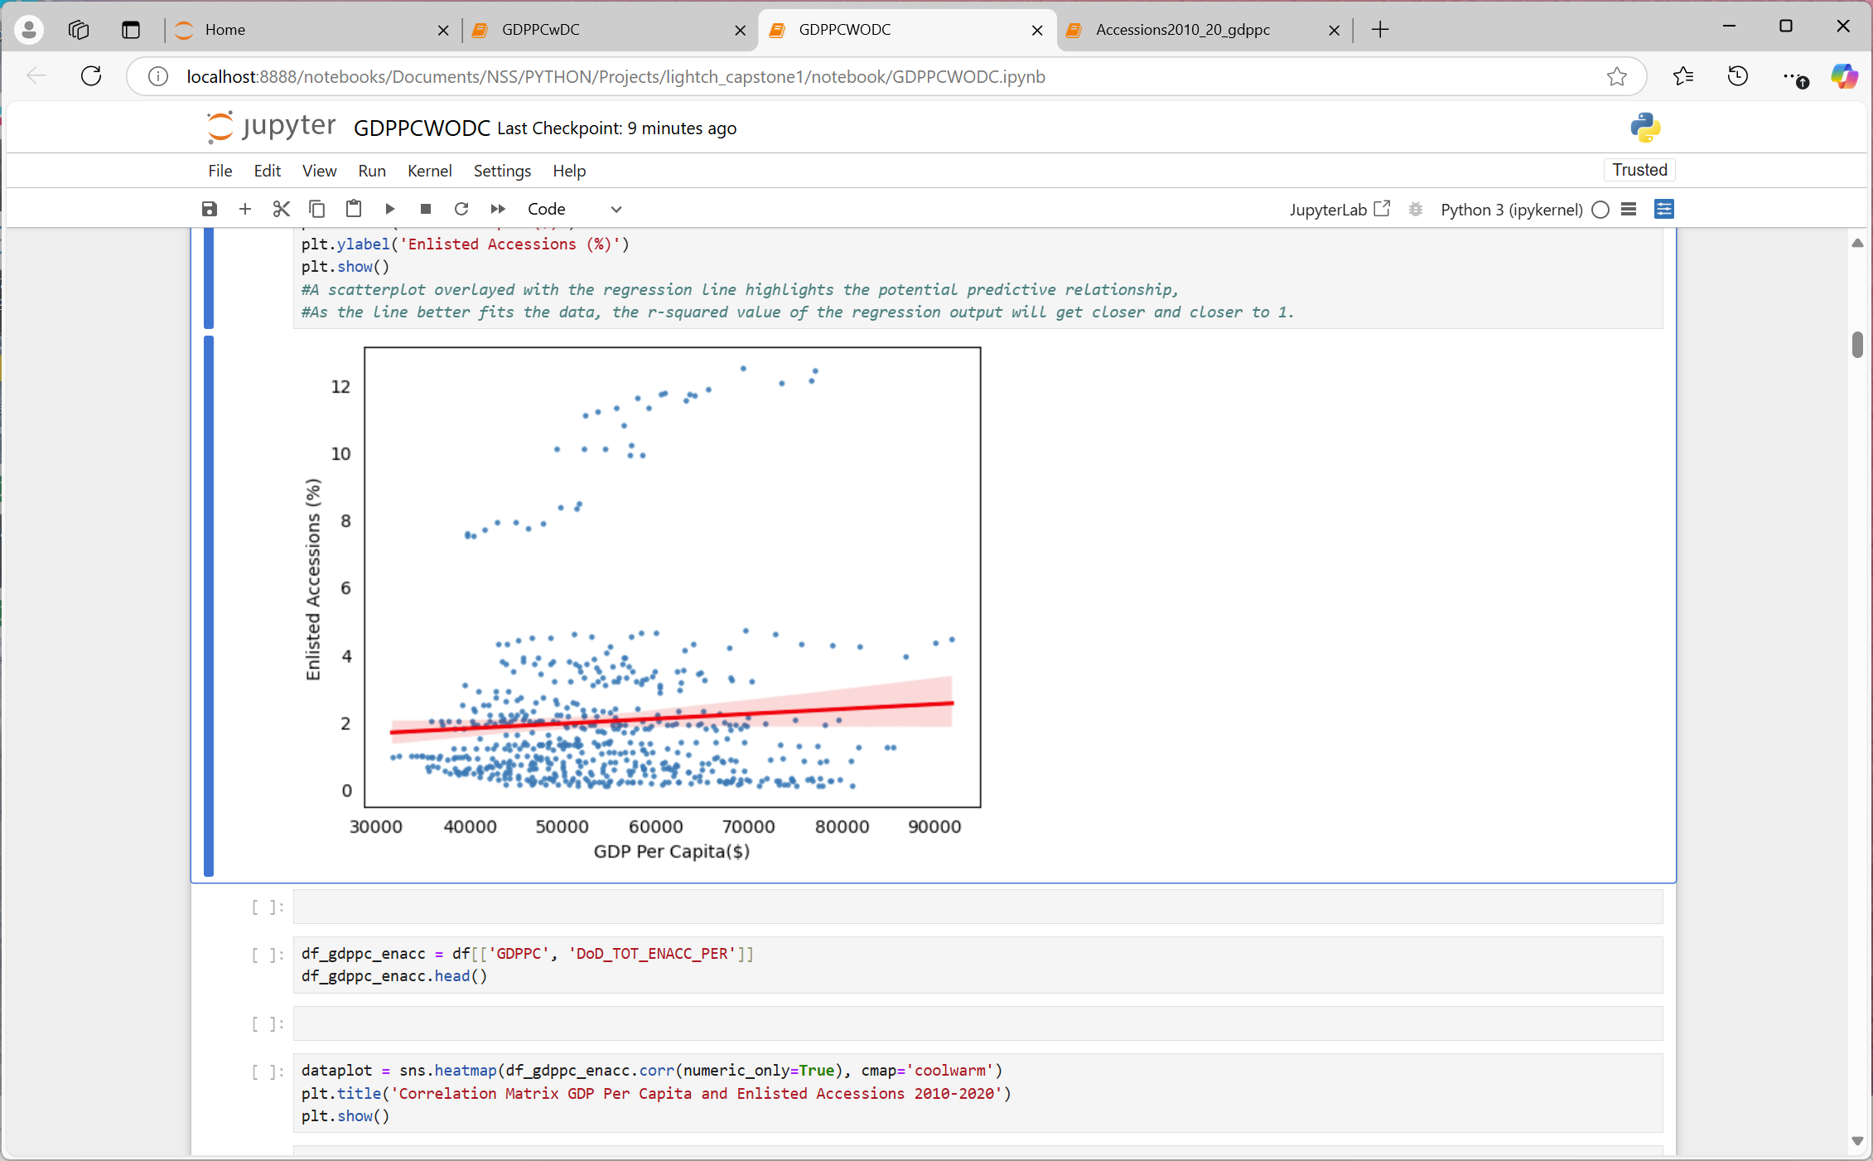
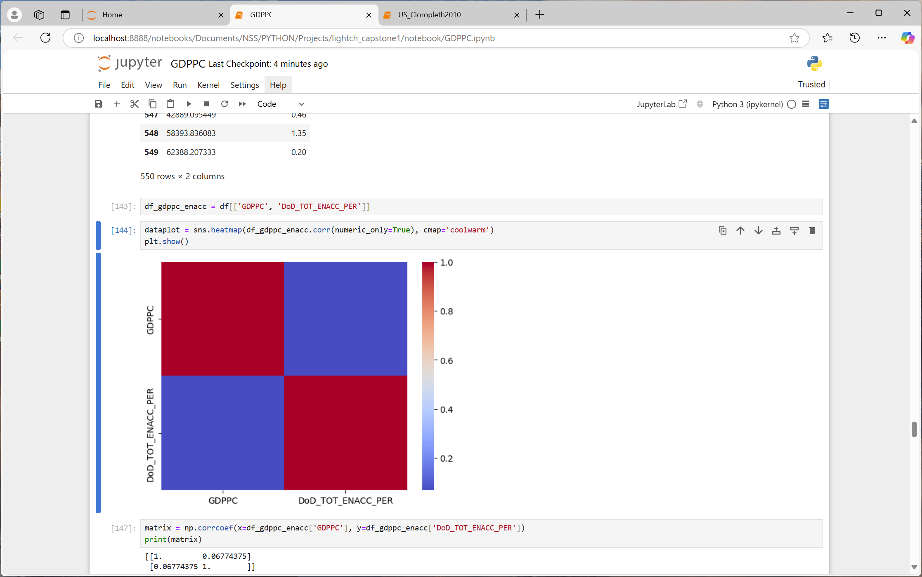
GDP PER CAPITA & PERCENT ENLISTED ACCESSIONS 2010-2020*
PQ3: Is there a relationship between GDP Per Capita and Enlisted Accessions?
1 | 0.0677
0.0677 | 1
*Washington DC removed

Slide 26
PROJECT FINDINGS 3
In general, there is a very weak relationship between GDP Per Capita and percent Enlisted Accessions, practically non-existent.
The GDP data for Washington DC seems to skew data for the US. With the DC GDP, there appears to be a negative correlation between GDP Per Capita and percent Enlisted Accessions. Without Washington DC, the data shows a positive correlation.

Slide 27
LIMITATIONS
Data:
My focus is on Active-Duty enlisted recruiting from FY2010 to FY2020, however, I include recruiting data from 1954 forward, to show more defined trends
Accessions reported for 1954-1963 include males only; including females would increase accessions by less than 2 percent.
Enlisted data from 1954 through 1973 likely includes draft/conscription numbers, not just volunteers
GDPPC calculated manually from US Census population estimates and Bureau of Economic Analysis

Slide 28
SUMMARY
PQ3: Is
there a relationship between GDP Per Capita and Enlisted Accessions?
PQ1: What are the Enlisted Accession trends over time?
PF3: No. The correlation between GDP Per Capita and Enlistment is very weak
PF1: Enlisted Accession have been decreasing over time
PQ2: Are
there areas
where Enlisted Accessions differs from the population?
PF2:
*NORTHEAST< *MIDWEST< *SOUTH> *WEST =
PROPOSED NEXT STEPS
Examine demographic trends impacting enlisted accessions

Slide 29






Slide 30
CONCLUSION/QUESTIONS
THANK YOU

Slide 31


